Slide 1
Frailty
Dr Pat McCaffrey – Divisional Medical Director
Catherine Sheeran – Assistant Director Enhanced Services

Slide 2
SHSCT - Demography
KEY POINTS
Over 65 | Population of over 65 grew by 54% in the 20 years to 2020 Population of over 65s expected to grow by further 57% from 2020 to 2043
Over 85 | Population of over 85s grew by 87% in the 20 years to 2020 Population expected to grow by a further 115% from 2020 to 2043
Ethnic minority | SHSCT has highest percentage of births to non-UK mothers across the five Trusts SHSCT was the highest requester for interpretating services – 49,848 requests
Under 18 | SHSCT had an increasing birth rate in the early 2000s which has led to the Trust having the fastest growing under 18 population

Slide 3
What is Frailty?
Frailty is defined by the World Health Organisation as “a progressive age-related decline in physiological systems that results in decreased reserves of intrinsic capacity which confers extreme vulnerability to stressors and increases the risk of adverse health outcomes”.
With frailty, even minor events can trigger disproportionate changes in health status after which the patient fails to recover to their previous level of health. Frailty is a spectrum disorder which ranges from mild to severe frailty.
Frailty is not an inevitable part of ageing; it is a Long-Term Condition (LTC) in the same sense that Diabetes or Alzheimer’s disease are. It varies in severity (individuals should not be labelled as being frail or not frail but simply that they have frailty). The frailty state for an individual is not static; it can be made better and worse.

Slide 4

Prevalence of Frailty
 | Southern AIPB Older Population from 2018 to 2033 |  |  |  |  |  | Southern AIPB Population with Frailty from 2018 to 2033
Age Band | 2018 | 2023 | 2028 | 2033 | % Change | Prevalence of Frailty | 2018 | 2023 | 2028 | 2033
65-69 | 16,583 | 18,712 | 22,051 | 24,272 | 46% | 4% | 663 | 748 | 882 | 971
70-74 | 14,766 | 15,408 | 17,458 | 20,644 | 40% | 7% | 1034 | 1079 | 1222 | 1445
75-79 | 10,843 | 13,012 | 13,673 | 15,607 | 44% | 9% | 976 | 1171 | 1231 | 1405
80-84 | 7,573 | 8,690 | 10,534 | 11,170 | 47% | 16% | 1212 | 1390 | 1685 | 1787
85+ | 6,480 | 7,695 | 9,078 | 11,129 | 72% | 26% | 1685 | 2001 | 2360 | 2894
Total 65+ | 56,245 | 63,517 | 72,794 | 82,822 |  |  | 5,569 | 6,389 | 7,380 | 8,501
More than one in ten people over 65 years in the community live with frailty.
Frailty affects over half of adults in hospital or care home settings.
1:10 over age 65 in community affected by frailty
Recent figures suggest frailty affects 50% pop over 85 (BGS 2023)
47% inpatients over 65 affected by frailty
Prevalence Source: Collard et al. JAGS 2012: 60; 1487-92
Population Source: NISRA

Slide 5
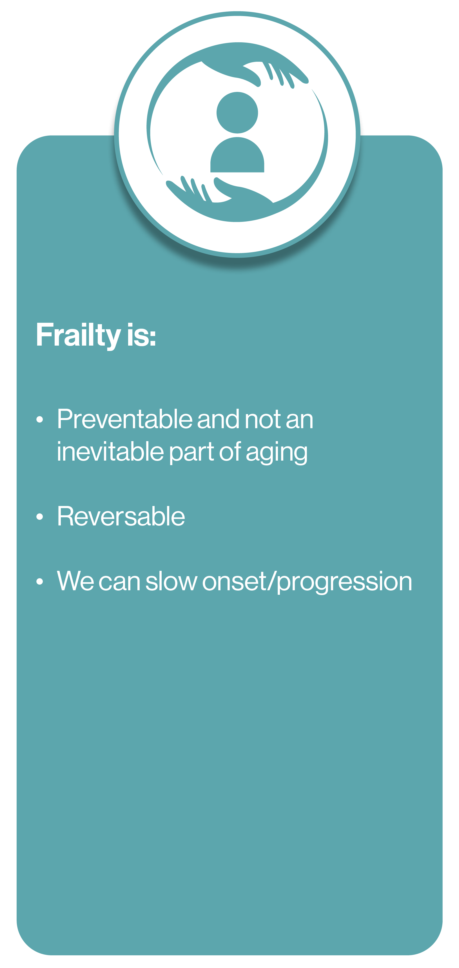
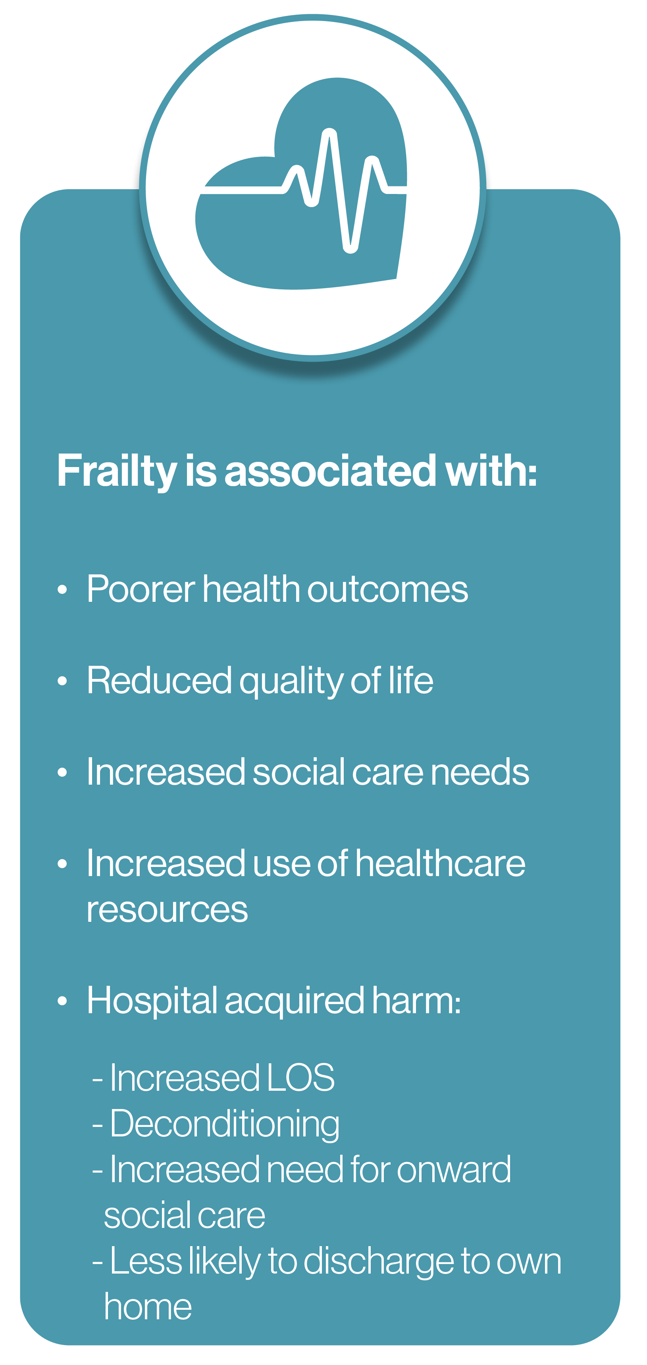
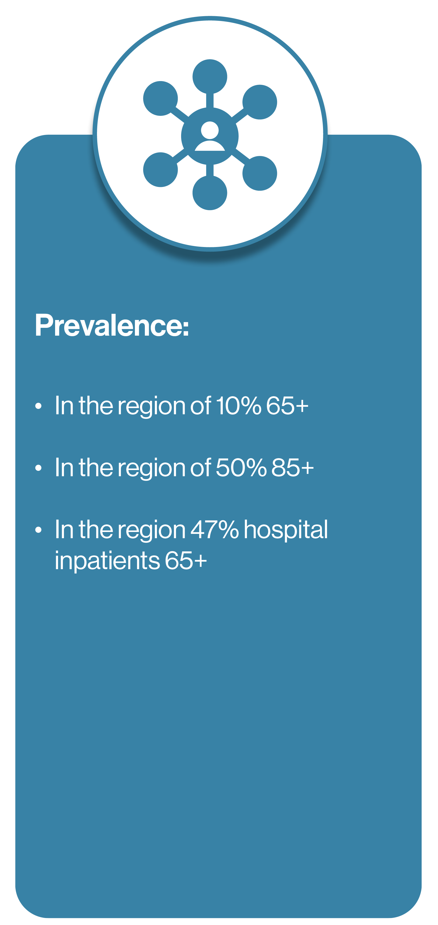
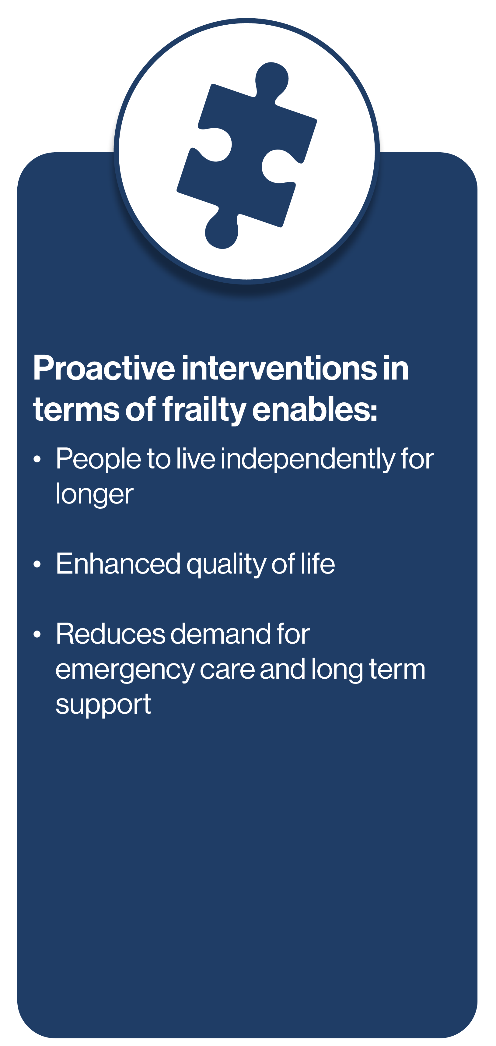
Why Frailty Identification is Important
Notes:
Highly evidence based tools for identifying frailty
Strong evidence base for intervention

Slide 6
Frailty Syndromes
There are 5 recognised frailty syndromes. The presence of one or more of these could indicate that the individual has frailty:
Falls
Immobility – sudden change, ‘gone off feet’
Delirium – acute confusion or sudden worsening of confusion in someone
with previous dementia or known memory loss
Incontinence – new onset or worsening or urinary or faecal incontinence
Susceptibility to side effects of medication
In additional to these syndromes, in Northern Ireland,
experts would also argue that social isolation and poor
nutrition are also factors which could indicate the
presence of frailty.

Slide 7
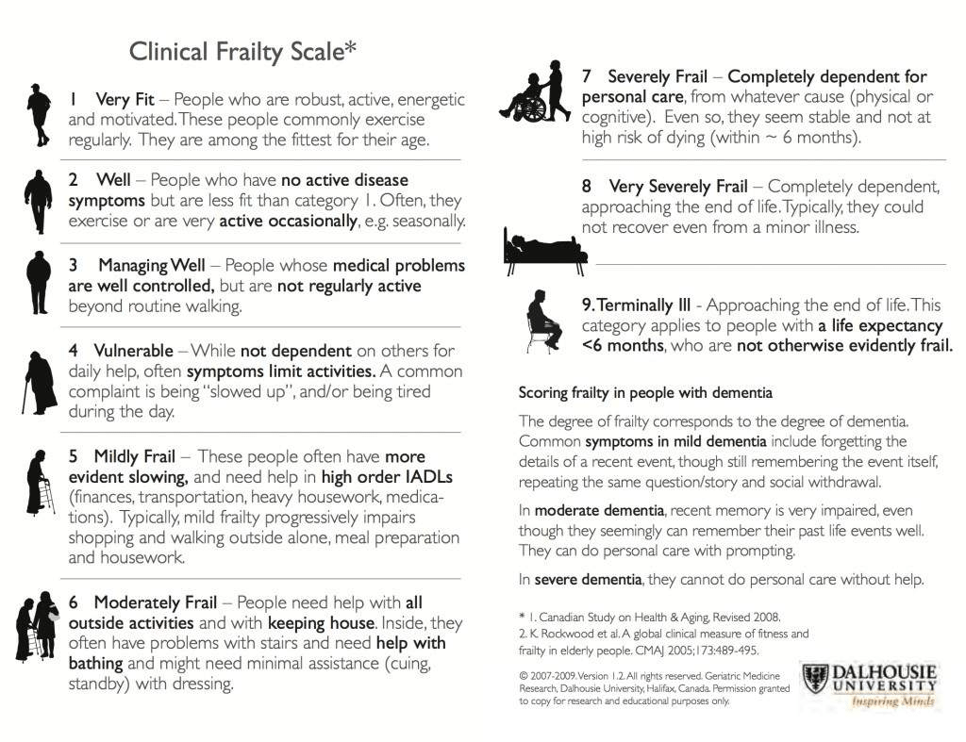

Slide 8
SHSCT Frailty
Everybody’s business
Continuum of Care

Slide 9
Vision
Set up of Frailty Steering Group
Develop and oversee implementation of a comprehensive frailty strategy
Ensure systematic identification of frailty across all care settings
Promote integrated care pathways that support comprehensive geriatric assessment and personalised care planning.
Facilitate collaboration between primary care, secondary care,
community services.
Promote staff education and training in frailty recognition
and management
Support research and innovation in frailty prevention and
management.
Advocate for resources and funding to support frailty
initiatives

Slide 10
Education Roll Out

Slide 11
Current Position in NI
Primary Care practices across NI are not currently contracted to identify frailty in their 65 + population using a validated tool.
The wider HSC (Inpatient and community services) do not routinely identify frailty in their 65+ population using a validated tool.
The Clinical Frailty Scale (CFS, Rockwood), is built into encompass but is not a hard stop, nor easily accessible within the system
We have no Prevalence data for Frailty in NI
Limited education/awareness for workforce in terms of
the significance of Frailty.

Slide 12
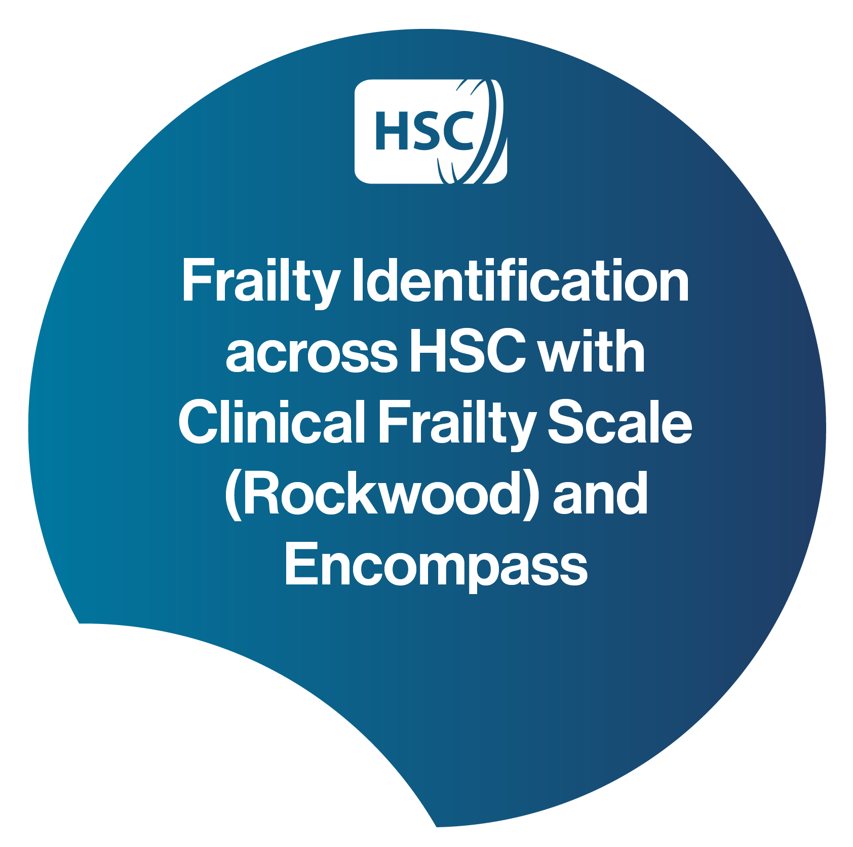

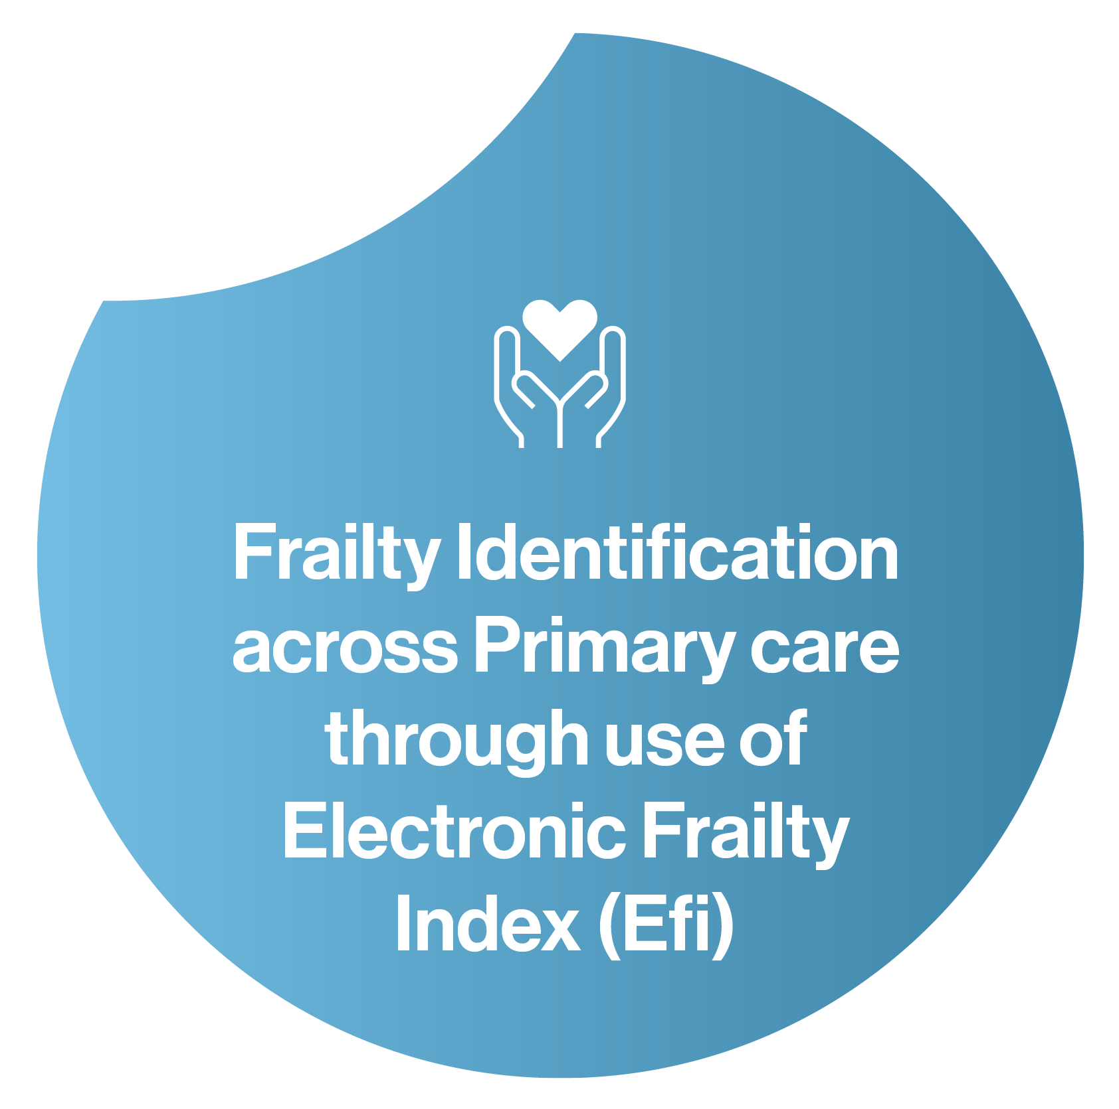
Outline of Workstreams to Deliver on Objectives

Slide 13
Tier 1: All staff, general public etc...
Access Arrangements / Notes
Module
Frailty Awareness – this is a general awareness programme and is suited to everyone. This will take around 30 minutes.
HSC Learn Platform – e-learning module
Our aim is that this will become mandatory for all HSC staff and part of all new staff inductions.
Linking with HSC Learn to secure access to this via NIFN Website for general population access

Slide 14
Tier 2: Un- registered / Pre-reg staff & students delivering indirect care to older adults
Module
Access Arrangements / Notes
As Tier 1 (above) plus:
• Fundamentals of Falls and Frailty (NB there is a universal falls session which is followed by one tailored to workplace setting – eg hospital, care home, community).
• Fundamentals of Delirium and Frailty
• Fundamentals of Nutrition and Frailty
• Fundamentals of Continence and Frailty
• Frailty Assessment (how to do a Clinical
Frailty / Rockwood Score)
Each module will take approx 30 minutes.
HSC Learn Platform – suite of self-directed e-learning modules called “An Introduction to Frailty”
Each of these modules will have a short assessment at the end where participants will be required to achieve a minimum pass mark of 80%.
Record progress.

Slide 15
Tier 3: Registered staff delivering direct clinical care to older adults
Module
Access Arrangements / Notes
As Tier 2 (above) plus:
Fundamentals of Polypharmacy and Frailty
Fundamentals of Cognition and Frailty
Fundamentals of Comprehensive Geriatric Assessment
Advanced Care Planning (in design)
Case studies, Groupwork and Discussion
Delivered in a face to face, group setting by trained Facilitators (Trust employees) after completion of online modules outlined above
Sessions currently arranged via Trusts through a facilitator programme.

Slide 16
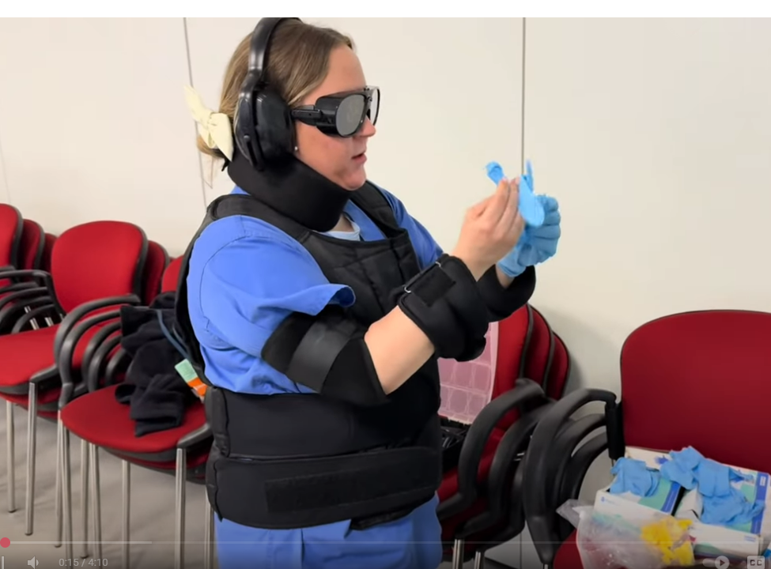
Stepping into their shoes
Doctor Elaine Nelson Frailty Simulation Training
Notes:
Who are our key stakeholders?
What are their education needs
How can we achieve these?

Slide 17
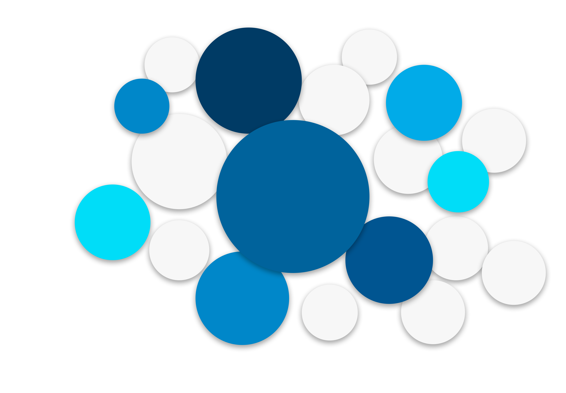

Frailty
SHSCT
Frailty at the Front Door
Falls
Rehabilitation
CAWT Identification and screening Mild
Careline Live
H@H
Dementia
Single Discharge Team
Frailty Beds
Delirium
End of Life Care
Frailty Integrated Team
NIAS
Education
Advanced Care Planning
Frailty Score
AIPB Project Moderate Frailty
Medical Ambulatory Pathways

Slide 18
CAWT Frailty Programme
To intervene earlier in order to help lessen the projected increase in pressures on our hospital health care services as a result of the ageing population which is growing rapidly.
CAWT Frailty project will support the transition from institutional to family and community-based care through establishment of a series of local community based Frailty-Education and Early Interventions teams who will help to identify people living with (or at risk of developing) frailty earlier, to allow early intervention and hopefully for those individuals it will help reduce the risk of avoidable hospital admissions in future.
Through local community delivery, it is anticipated that the new Early Frailty Intervention teams will help older people to live well at home and create strong community presence, promoting positive aging initiatives into the wider localities.
Greater education and awarness about Frailty will help with earlier escalation for those who are deteriorating/at risk of deterioration either medially or functionally and in turn improve patient experience.

Slide 19
CAWT Frailty Programme
The main outputs from the project will be:
8,300 older people across the border region between NI and RoI will be provided with community/homebased Early Intervention episodes of care such as:
  screening for frailty and /or
  frailty education sessions and /or
  onward referral to health practitioner and /or
  monitoring by telephone or other device if deemed necessary
  onward referral for community social prescribing, exercise,etc
2075 beneficiaries in SHSCT.

Slide 20
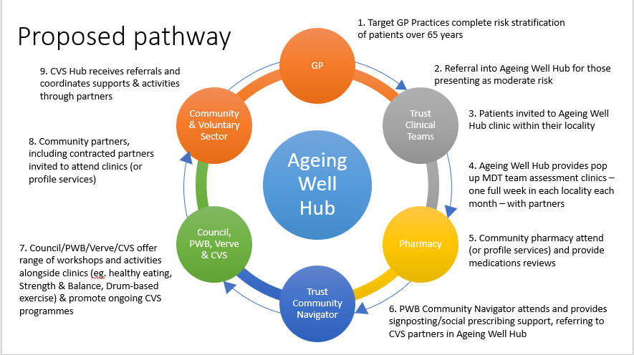
AIPB Frailty Project

Slide 21
Focus on Community
Core Physiotherapy
Reablement
Intermediate Care
Single Discharge Team
Day Hospitals
Rapid Access Clinics
Hospital at Home
Frailty at the Front Door
Bed Based Care
Non-Acute Hospitals
Frailty Wards.

Slide 22
Next Steps
Continued focus on Frailty
Community First approaches supported
Communication Engagement Plan across Primary, Community and Voluntary, Secondary Care and our Public
Thank you!

