Slide 1



The Infant Mental Health Project in SHSCT i-CAMHS
Majella Connolly
Infant Mental Health Practitioner, Team Leader, i-CAMHS
23 04 2020

Slide 2

What is Infant Mental Health
Infant mental health refers to the social,
emotional and intellectual well- being of
children 0-3years in terms of their relationship with their parents/primary carers and the caregiving experiences received in the family home

Slide 3
The Growing Evidence
There is a huge evidence base in support of the importance of parents/main carers promoting their infant’s mental health for example:
Attachment research
Child development research
Neuroscience research

Slide 4
Why is your baby’s mental health & emotional well being so important?

Slide 5
“ The period between pregnancy and 3 years is increasingly
seen as a critical period in shaping children’s life chances,
based on evidence of brain formation, communication and
language development and the impact of relationships
formed during this period on mental health”
“It is also a crucial time to intervene”
Early Years Framework 2008

Slide 6
Promoting your infant’s mental health can …….

Slide 7
Promote
Brain development
Language development
Social development
Gross and fine motor development
And most importantly,
your baby forming a secure attachment to you

Slide 8
And Can Prevent….

Slide 9

Attachment Disorder

Slide 10
Violence

Slide 11

Mental Health Issues Later on in Life

Slide 12
Drinking alcohol in pregnancy can cause:
Foetal Alcohol Syndrome
Foetal Alcohol Spectrum Disorder
Which are both lifelong

Slide 13
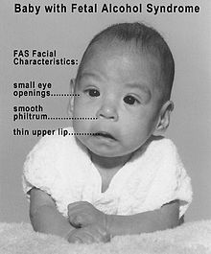

Slide 14
Foetal Alcohol Syndrome
&
Foetal Alcohol Spectrum Disorder
Are Both
100% Preventable;
By avoiding alcohol in pregnancy

Slide 15
“What happens in the early years can affect the course of development across the lifespan”
Deborah Weatherston WAIMH

Slide 16
How You Can Promote Your Baby/Child’s Mental Health
Avoid alcohol and drug substances in pregnancy
Look at, smile at, talk calmly to, sing and read to your baby/ child everyday
Set aside time to play with your child everyday
Hold, cuddle, gently rock, stroke, encourage skin to skin contact, soothe and comfort your baby/child everyday

Slide 17
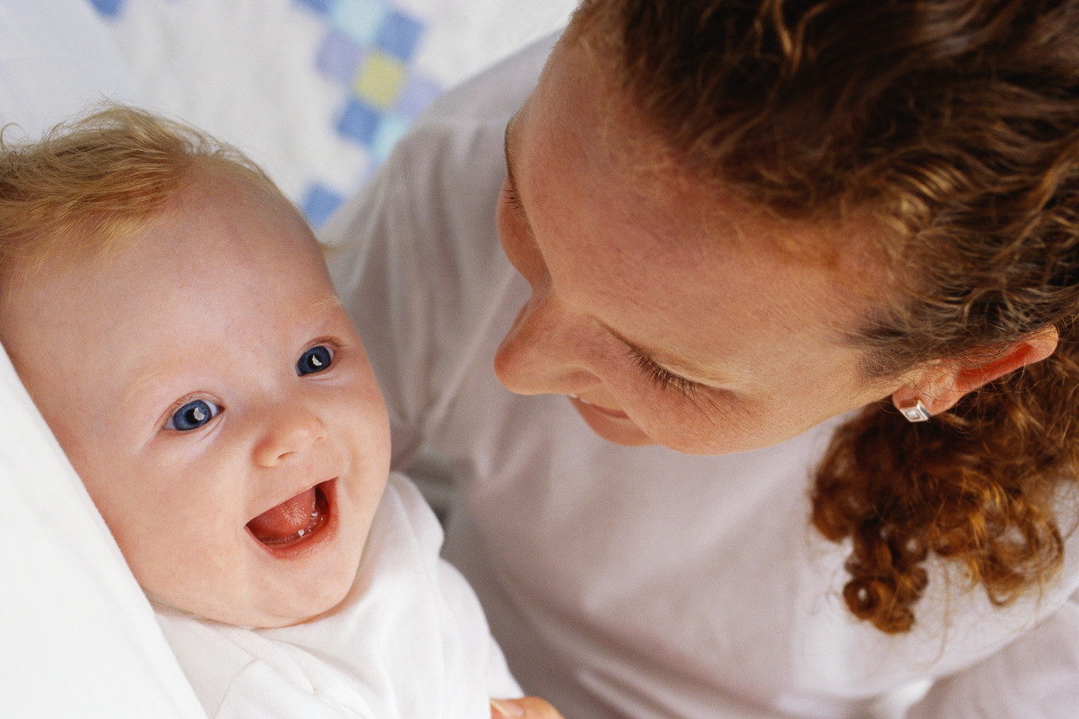

Slide 18
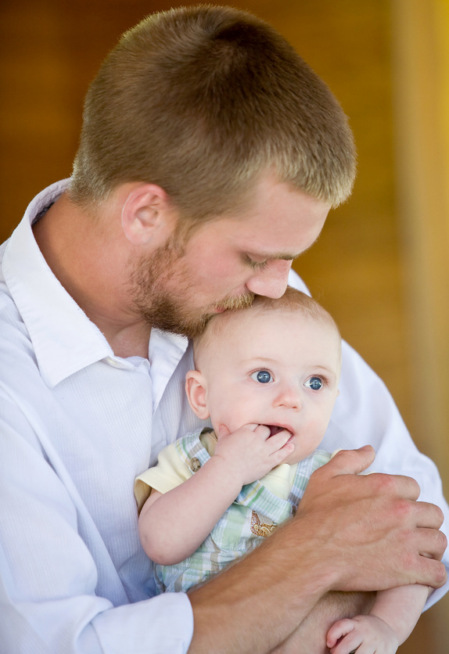

Slide 19
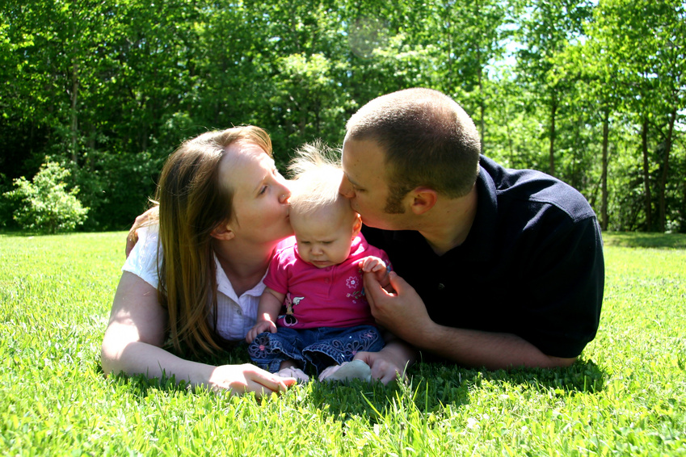

Slide 20
There is a huge volume of research
to highlight
the importance of
bonding with your baby
in the early years.

Slide 21
However, for numerous reasons
Sometimes,
love can take time to grow.

Slide 22
That is okay
There is support available to help you with your developing relationship with your baby/child
Talk to your professional for advice and support and request onward referral to i-CAMHS if you feel additional help is required

Slide 23
Intervention Offered at i-CAMHS:
1:1 support in a central locality at a time that is suitable for you
Parenting advice and support delivered in a sensitive, empathetic, non judgemental manner
Systemic & Psychoanalytical practice
Trauma support and interventions particular around the delivery of your baby
Video Interaction Guidance (VIG) used as a therapeutic tool (with your consent)
Cognitive methods and psychoeducation about your child

Slide 24
Promoting the Parent Child Relationship
“Helping parents understand and respond to their infant’s unique way of communicating is probably the most important intervention to the infant’s development of a secure attachment.”
P. Svanberg 2002

Slide 25
