Slide 1
GP Zoom meeting
Dr Pat McCaffrey
Lead Consultant Geriatrician

Slide 2
Acute Care at Home Service
Dedicated Consultant Geriatrician led multidisciplinary team
Primary focus is on maintaining older people at home/Nursing/Residential in the event of an acute illness or unexpected deterioration in health
Provides triage, assessment, diagnosis and treatment as an alternative to in-patient care to those at risk of or potentially requiring admission to hospital treatment.

Slide 3
Criteria
Inclusion
Exclusion
Over 65 years (Under 65 considered on individual basis if hospital admission would be detrimental)
Live in the Southern Trust Area
Any patient not deemed critically unwell
Patients must have been assessed as requiring acute care i.e. deemed to be at the point of hospital admission.
Can be managed safely in a community setting
Requires resuscitation
Chest Pain
Acute Surgical or Orthopaedic Crisis
Stroke
Haemostasis / GI Bleeding
Mental Health – picked up through Home Treatment Crisis response

Slide 4
Community Rapid Response
COVID-19 outbreak – reconfiguration of teams
  Acute Care at Home
  Community Respiratory
  Heart Failure
  Care Home Support team
  Single point of contact for GPs
  GP to complete telephone triage before referral
  Patient must be at the point of an acute admission

Slide 5
Care Home Advice Line
We have an advice and support line for care home managers and Trust staff.
Operational hours for referrals are 7 days 9am – 5pm.
If you would like to contact the advice and support line please call 028 37 563591.
Available for both COVID and non-COVID patients
Queries do not need to be about AC@H patients

Slide 6
Proposed COVID follow up
Care homes

Slide 7
RESTORE 2
Recommended by British Geriatric Society for use in Care Homes
A physical deterioration and escalation tool for care homes.
Nationally recognised methodologies
  early recognition (Soft Signs),
  national early warning score (NEWS2)
  structured communications (SBARD).

Slide 8
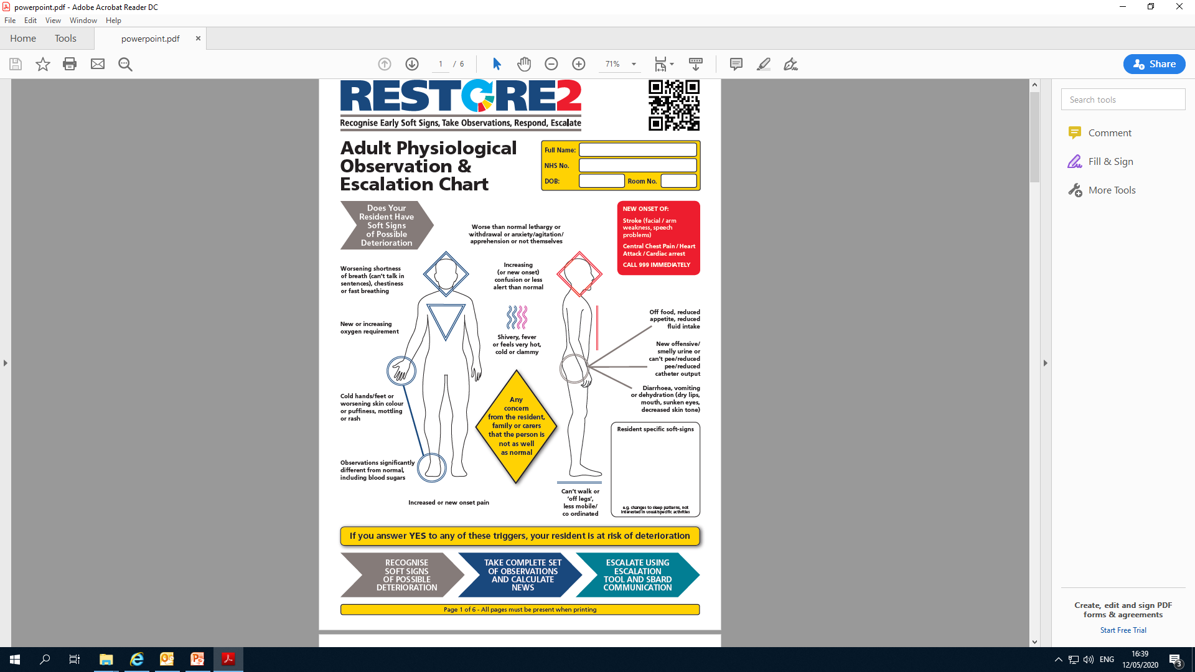

Slide 9
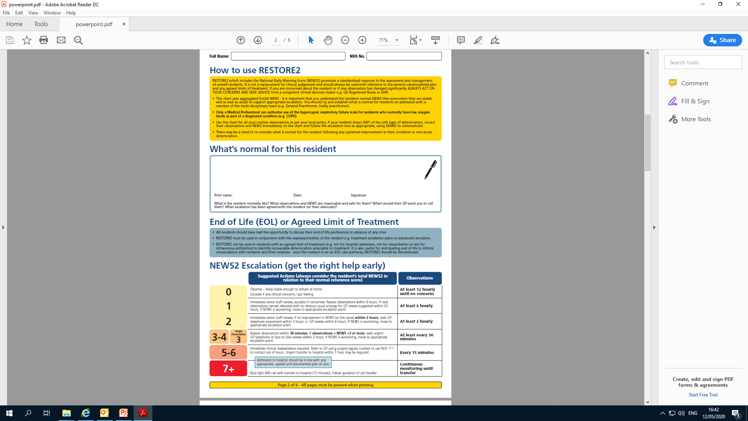

Slide 10
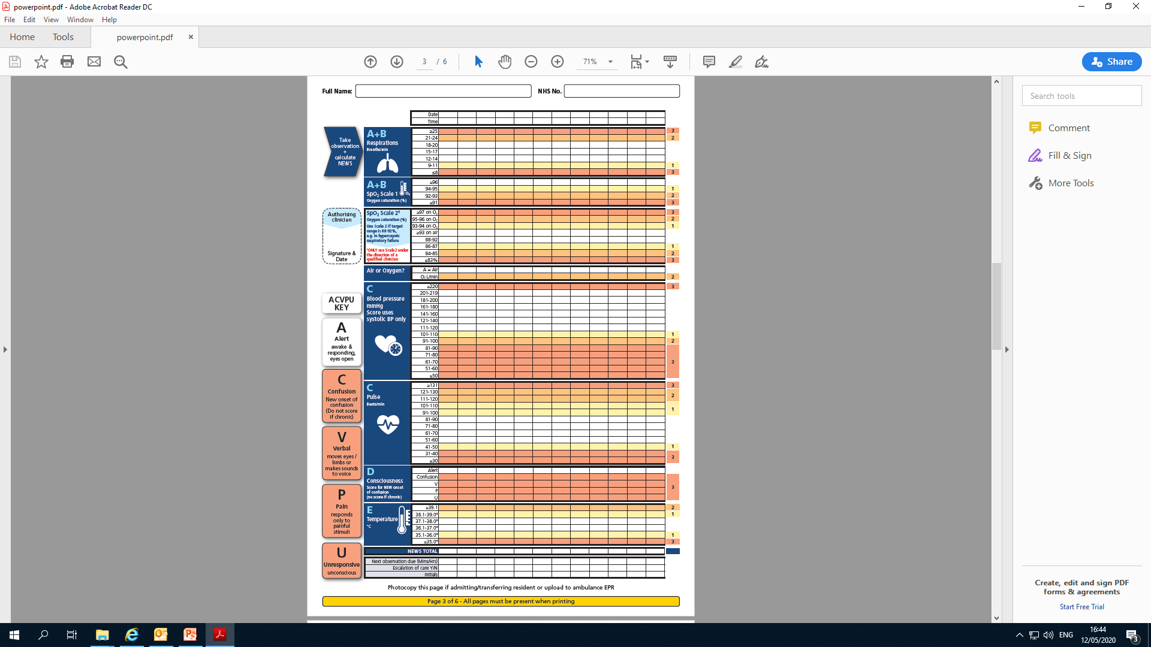
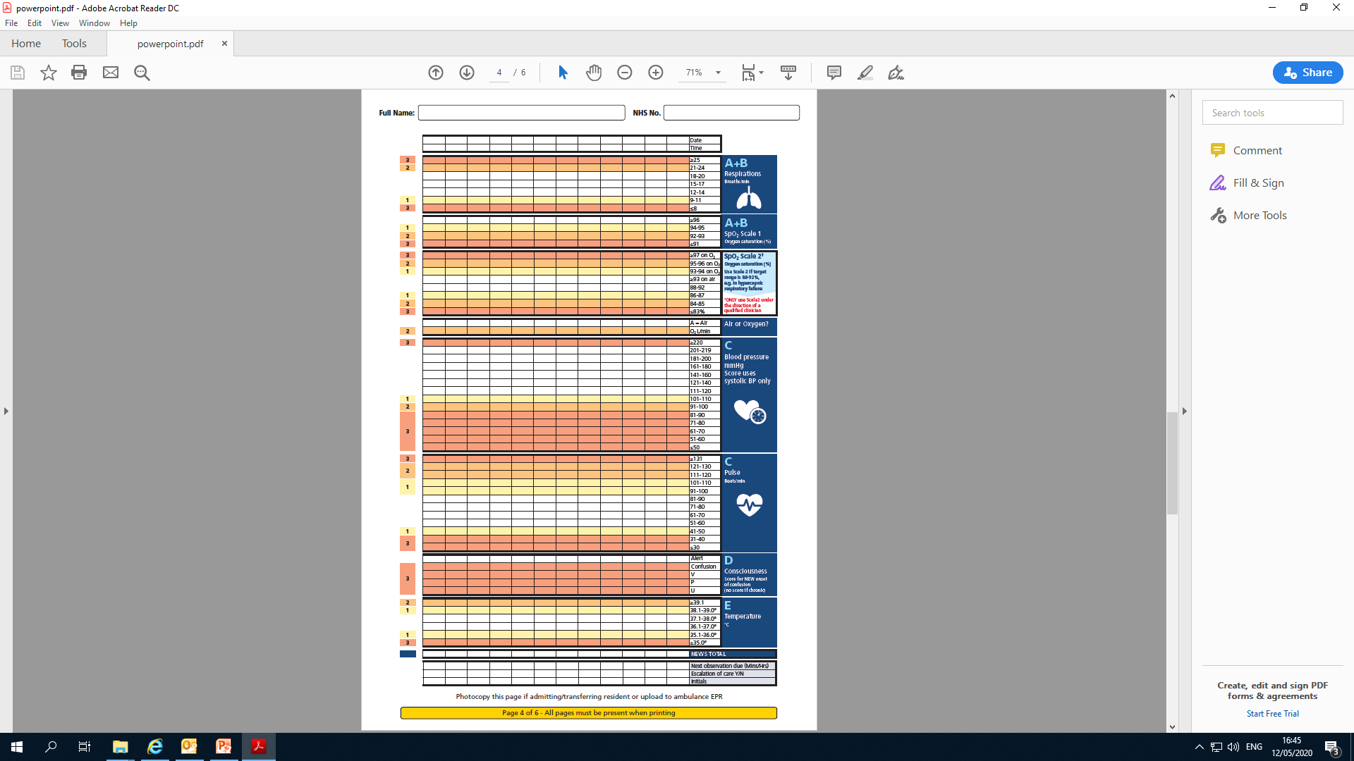

Slide 11
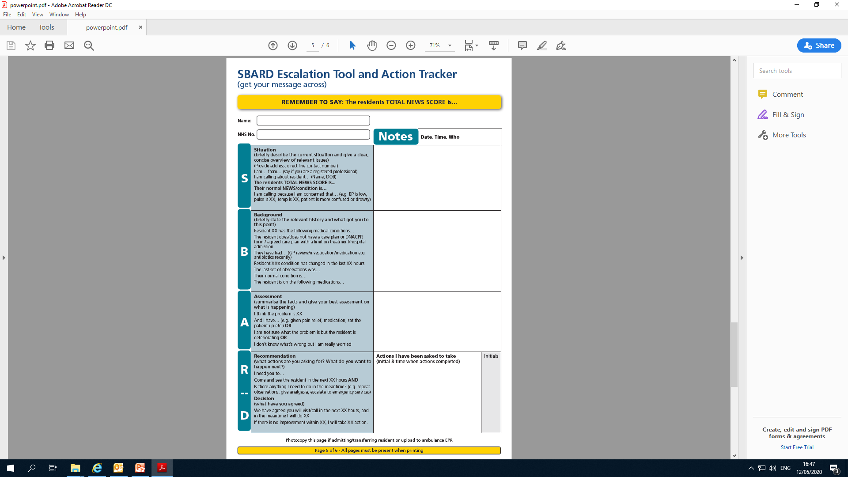

Slide 12
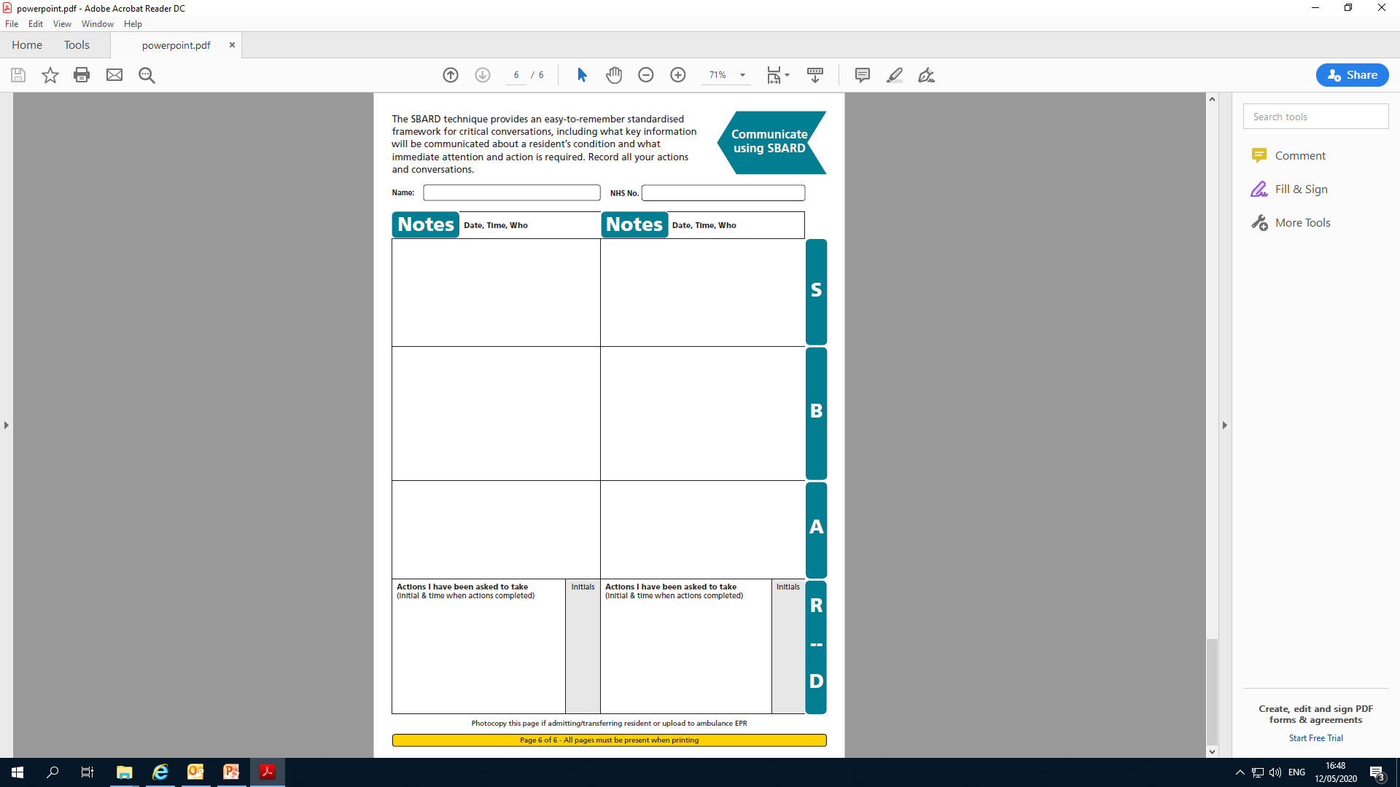

Slide 13
For consideration
Link with GPs to refer both COVID and non-COVID patients
Anticipatory medication
Oxygen – if new, link with GP for referral to AC@H
Link to RESTORE 2 Tool:
https://westhampshireccg.nhs.uk/restore2

