Slide 1

Death and bereavement during covid-19
Care Home training
20th May 2020
Dr Sharon McCloskey:
Bereavement Coordinator

Slide 2
Introduction
What is happening in hospital setting/transferability to care homes
What else would be of help
Bereavement support
Self and team care

Slide 3


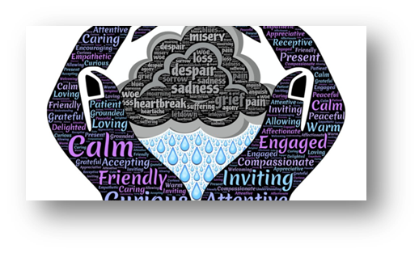
The art and the science of care

Slide 4
What relatives have told us is important
Communication
Presence
Compassion
Empathy
Care

Slide 5
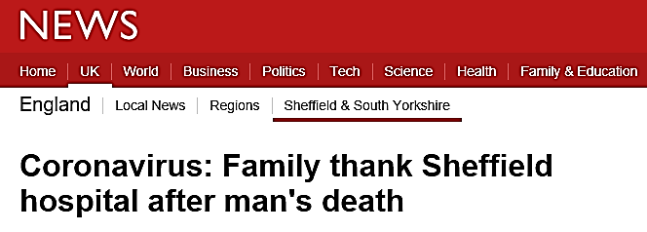
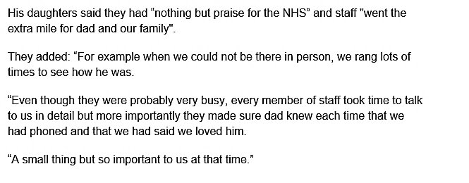
Small acts of kindness

Slide 6
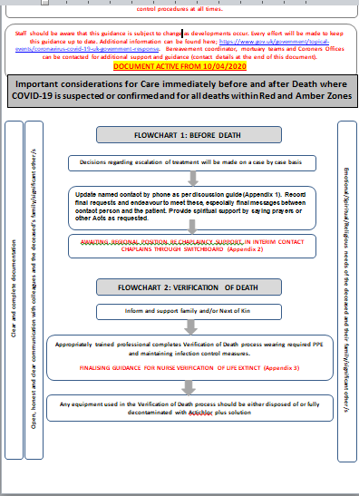
Care after death flow charts
Care before death (aide memoires)
Admission
Update
Deteriorating
Helping relatives to say goodbye
After death
Spiritual/religious support
Verification of death

Slide 7
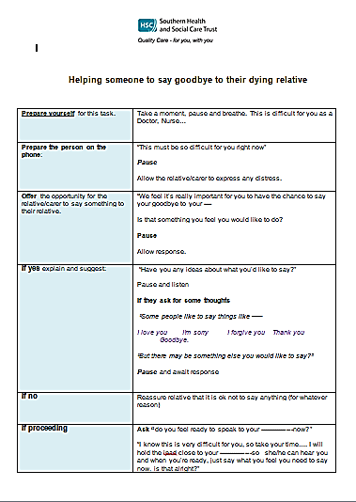
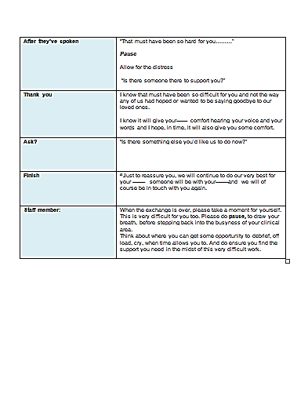
Helping relatives to say goodbye

Slide 8


Communication routes

Slide 9
Communication
Disposition: “Compassionate listening”
Compassion: “noticing and responding to suffering in others without being overwhelmed by it.
Before, during and after skills

Slide 10
Before
Tune into self: what is happening in me, what do I need to attend to so that I am able to connect with the person?
Tuning into the other: how might the caller be feeling? What might be going on for them?

Slide 11
During
Challenges of communication by phone
Not only what you say, but how you say it.
Importance of tone of voice
Power of pause
Clear, concise, jargon free information
‘Chunk and Check’
Pay attention to cues: what isn’t being said
Power of silence
Don’t try to fix, sit with distress

Slide 12
After
Pause
Breathe
Record

Slide 13
Useful communication strategies
ICE
Seek the person’s Ideas /understanding of the situation
Identify their Concerns
Taking their concerns into consideration, what are their Expectations or what are they hoping for.

Slide 14
A wish, worry and wonder
Managing unrealistic expectations
I hear what you are saying, if this was my mum/dad, I would be Wishing for exactly the same thing.
But I’m worried. I’m Worried because …… we might not be able to get that wish.
I Wonder, if this is what happens, is there something else you might wish for?

Slide 15
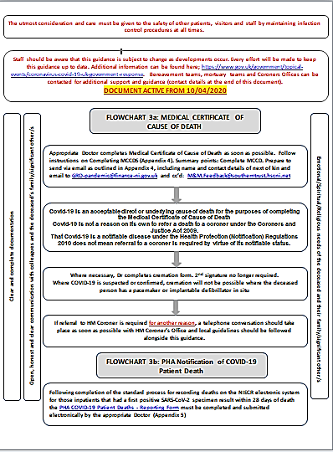
Flow Chart 3a & b
MCCD
COVID-19 position as per MCCD: Swab results are not definitive

Slide 16
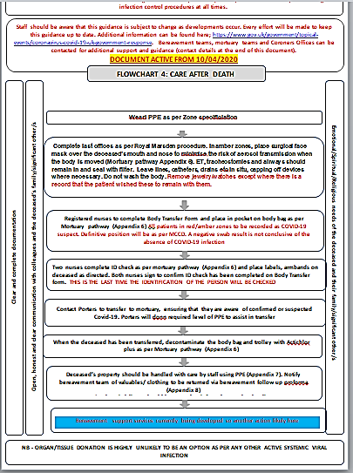
Flow chart 4
Last offices
Risk
Washing
Identification
Body bag
Transfer/release to funeral director

Slide 17
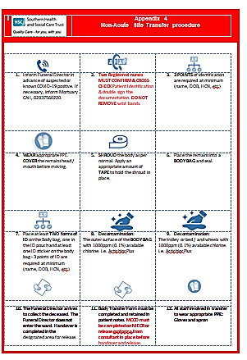
Release to funeral directors

Slide 18
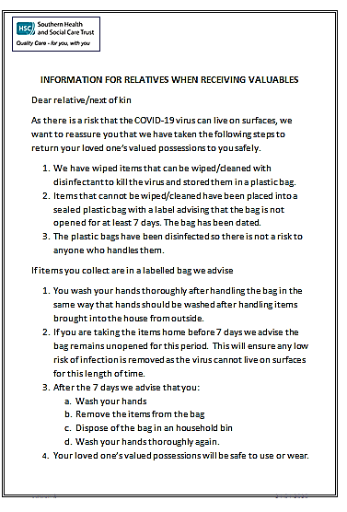
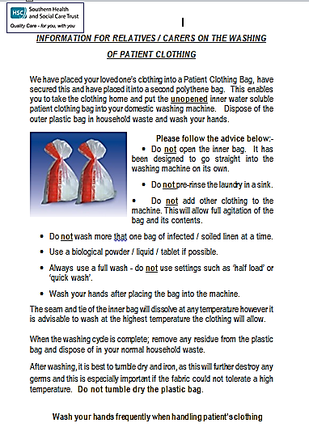
Clothing/valued belongings

Slide 19
Bereavement
Universality of bereavement
COVID-19 pandemic
Grieving in exceptional times
Need to integrate bereavement support into our services

Slide 20
Grieving in exceptional times
Separation at end of life
Sudden, rapid decline
No exposure to sensory reality of death
Unanswered questions
Feelings of guilt and remorse
Social distancing
Absence of established rites and rituals
Grief on hold

Slide 21
Grief
Grief is our response to loss
There is no right or wrong way to grieve.
The loss is permanent, and grief is permanent however the intensity of the feelings will change over time.
Most people will move through grief with the support of their family and friends.
Some will need specialist support.

Slide 22

Model of bereavement support
Care team
Pre-death
Communicating with relatives from admission, as their loved one’s condition deteriorates, when they are saying goodbye and after their death.
After death
Sympathy card hand written by the nurse/team
‘Heart’ symbol of connection

Slide 23
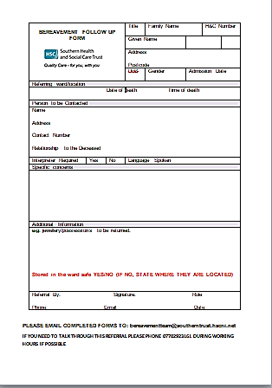
Model of bereavement support
Bereavement team
After death
Letter from the Trust in information pack
Follow up phone call to next of kin
Bereavement support help line

Slide 24
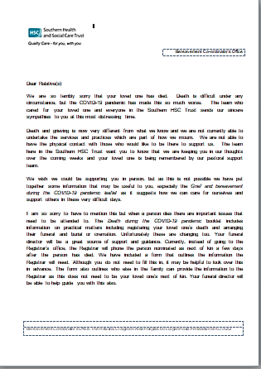
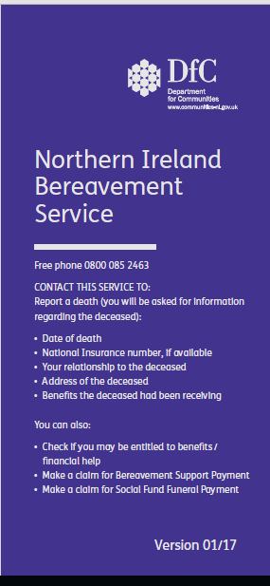
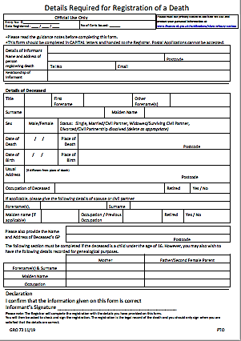
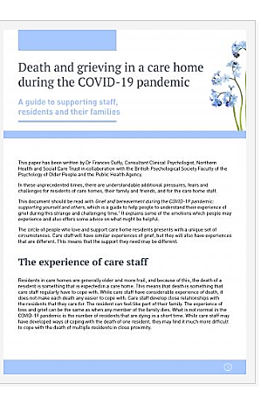
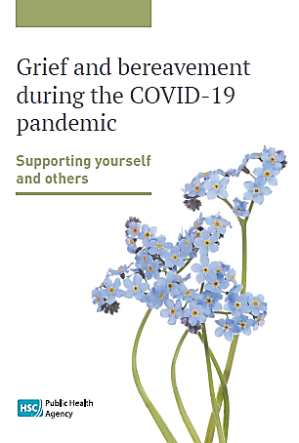
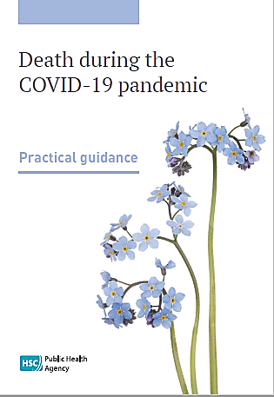
Information pack

Slide 25
Outreach call
Approx. 3-5 days after the death
Offer condolences
Check how the person is
Check they received an information pack
Listen to the story
Check if there are queries or concerns
Provide information
Offer further follow up call

Slide 26
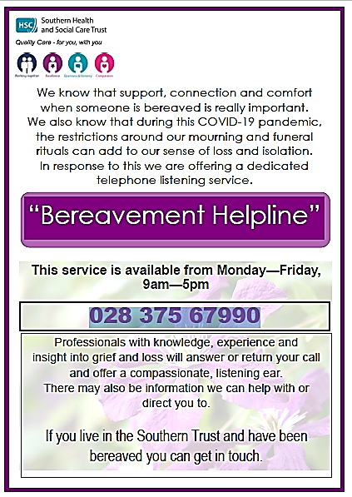
Helpline purpose
To come alongside bereaved people, to hold their grief and offer emotional support through compassion and empathy.

Slide 27
Helpline purpose
To help the person understand their grief in the context of ‘normal’ grieving
To sensitively suggest and encourage the person to identify ways to help them cope with grief and attend to their self care
To provide information where helpful
To signpost to other services for practical and/or emotional support.
It is not a counselling service

Slide 28
Looking after yourself
“The expectation that we can be immersed in suffering and loss daily and not be touched by it is as unrealistic as expecting to be able to walk through water without getting wet. This sort of denial is no small matter. The way we deal with loss shapes our capacity to be present to life more than anything else.” (Remen, 1996)
While your experiences are likely to be challenging, resilience theory tells us we do not need to be damaged as a result of them. They also bring opportunities for personal growth.

Slide 29

Impact
Emotional load
Fear
Frustration
Anger
Sadness
Grief
Satisfaction
Peace
Accomplishment

Slide 30
Circle of influence (Covey, 1989)
Circle of control
Circle of influence
Circle of concern

Slide 31
What resilience theory tells us
Be self aware
Seek balance
Recognise what is adding pressure
Know what has helped in the past
Develop new resilience behaviors
Be aware of longer term consequences of unhelpful behaviours

Slide 32
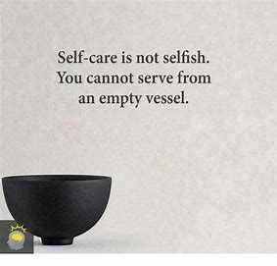
Invest in yourself
Develop self-awareness
Emotion awareness
Compassion fatigue
Boundaries
Emotion awareness
Down time
Maintain a network of support
In work
Peer support
Debrief
External
Sustain healthy habits
Exercise
Diet
Downtime
Identify problems & take action

Slide 33
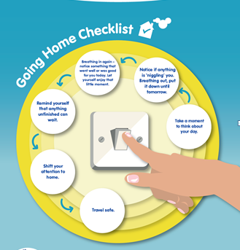

Slide 34

Invest in your team
Always be kind because people are often dealing with pressures you know nothing about.
Team camaraderie
Team concern
Respect for roles
Talk
Make emotional support the norm
Team celebration and remembering

Slide 35
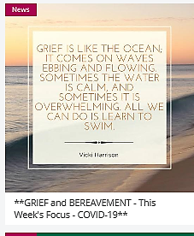

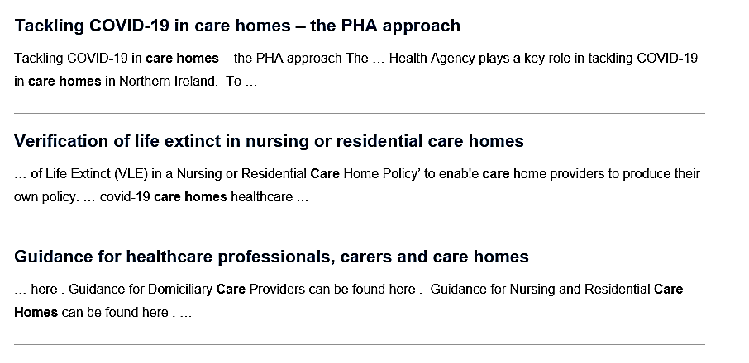
Resources
https://u-matter.org.uk/news/grief-and-bereavement-weeks-focus-covid-19

Slide 36
Credits and references
Communication slides: Deirdre McKenna, service improvement lead for dementia services, SHSCT & Dr Suzie Wilkinson, Advanced Communication Skills Training resources
Covey, S. (1989) 7 Habits of Highly Effective People Simon & Schuster: New York
Donnelly, Donnelly, S. (2013) Patient dying in hospital: an honoured guest in an honoured place? Q J Med 106:697–700
Remen, R. (1996) Kitchen table wisdom: stories that heal Penguin: New York

