Slide 1



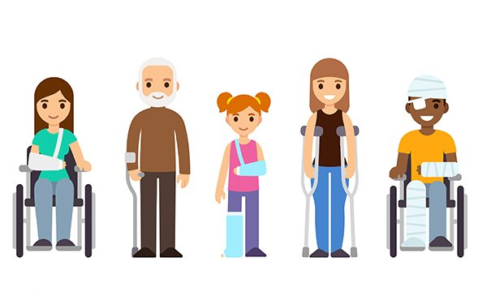
Emergency Paediatric first aid training
Are you working with or caring for babies or young children?
Do you feel basic knowledge of first aid would be useful in your role?
This course aims to train delegates in the essentials of dealing with emergencies with an emphasis on those involving children. It includes basic life-saving skills, handling life threatening situations and responding to common, minor ailments. This is also an appropriate refresher course to meet current requirement standards.
Continuous assessment of theory and practical skills will take place to ensure competence.
On successful completion delegates will be awarded an attendance certificate valid for three years. Good practice expects a refresh on aspects of first aid skills at least annually.
Delegates are required to be physically fit and able to cope with intense study in English and practical activity.
Thursday 26th October 2023
Dobbin Street Community Centre, Armagh
Or
Monday 6th November 2023
Ballysaggart Business Park, Dungannon
10am – 4pm
BOOK YOUR PLACE HERE:
E: pwb.training@southerntrust.hscni.net

