Slide 1


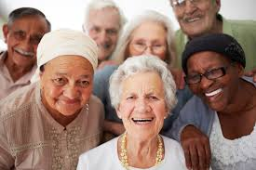

RoSPA Older People’s Safety in the Home
This course will provide an overview of home accidents and an insight into injury prevention in critical areas.
It is aimed at those who play a role in the prevention of accidents in the home for older people:-
People caring for older people in the home.
Volunteers supporting older people, health professionals from community and voluntary sector and statutory organisations
Delegates will develop skills in:
Promoting safer home environments
The importance and need for home safety
Recognising who is most at risk from home accidents and why
The causes, consequences and related costs of home accidents
Accident prevention measures and methods of assessing, prioritising and controlling risk
Effective interventions and how to evaluate them
All delegates will receive a RoSPA certificate on completion of training.
This course qualifies for Continuing Professional Development points.
2020 dates TBC
9.30am – 4.30pm
The Promoting Wellbeing training room
St Luke’s site
ARMAGH
To book a place please request an application form from:
email: pwb.training@southerntrust.hscni.net
Closing date for applications:
TBC

