Slide 1




A Road Less Travelled.. By The Short Breaks Team.. SHSCT (CYP Directorate)
Notes:
Vicky
Hello my name is vicky Mcconville – I am an Organisational Development Practitioner for the Trust. My role here today is just to support & introduce this wonderful Short Breaks team in telling their remarkable story on …. ‘ A Road Less Travelled’….
I will now pass you over to Mark Irwin who will give a brief Introduction to this presentation and some background information…

Slide 2



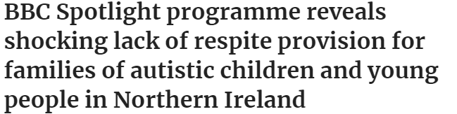

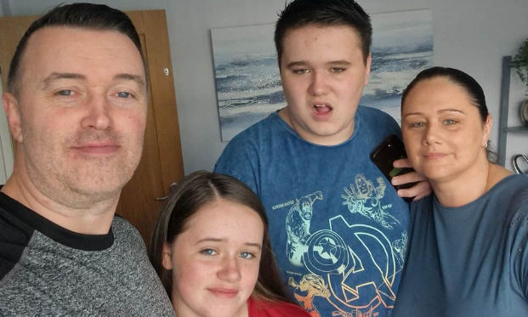
In the Beginning…
Notes:
MARK – to read his bit…
Vicky – ‘thank you Mark for sharing some background information…you have set the scene for the innovation behind this … and the many roles you played to help create and develop this service…

Slide 3
Words from a Parent...
“The carers are very professional, they are warm and inviting to our child, keep our child safe and they provide all the good things that you want from a placement”.
Notes:
MARK –
Mark to read out quote on screen ….
Then over to Arlinda…
Arlinda - to read out her bit (leave this slide on screen)

Slide 4
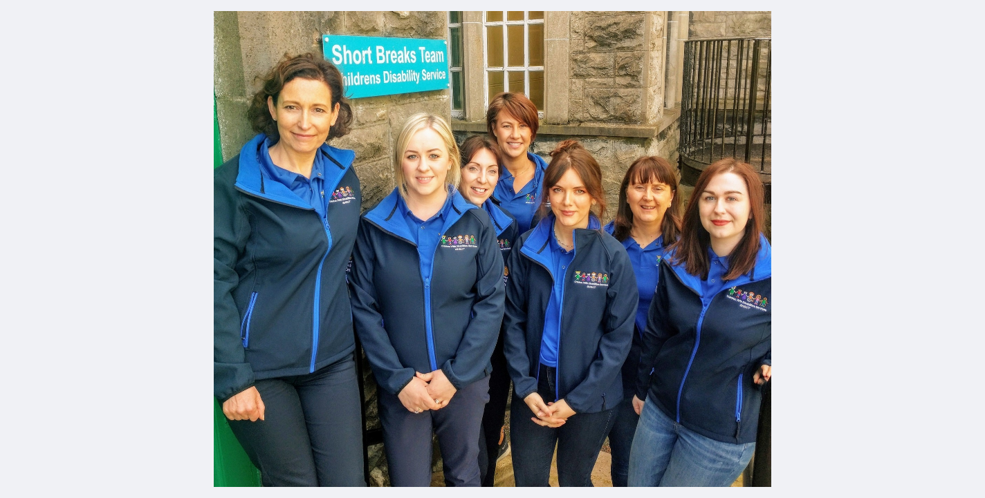

The Short Breaks Team..
Notes:
Arlinda to say –’this is some of the Team behind all the hard work..’
Then

Slide 5
Words from a Parent...
“ B loves going down to J’s. He is at home there, he takes his shoes off and switches over the TV channel”. “He is lord of the manor when there”. “I am happy with the support”.
Notes:
Arlinda to read out… ‘words from a parent’… read …

Slide 6
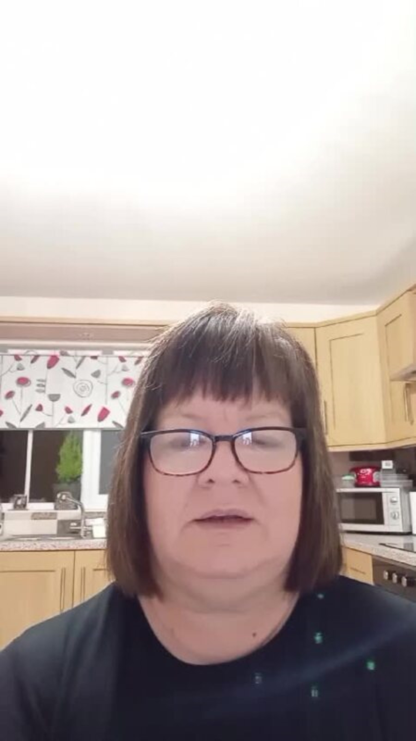
Carers Story….
VID-20241113-WA0002.mp4
Notes:
Arlinda to introduce video – saying ‘this is one our current carers giving her perspective…
Vicky to play video

Slide 7
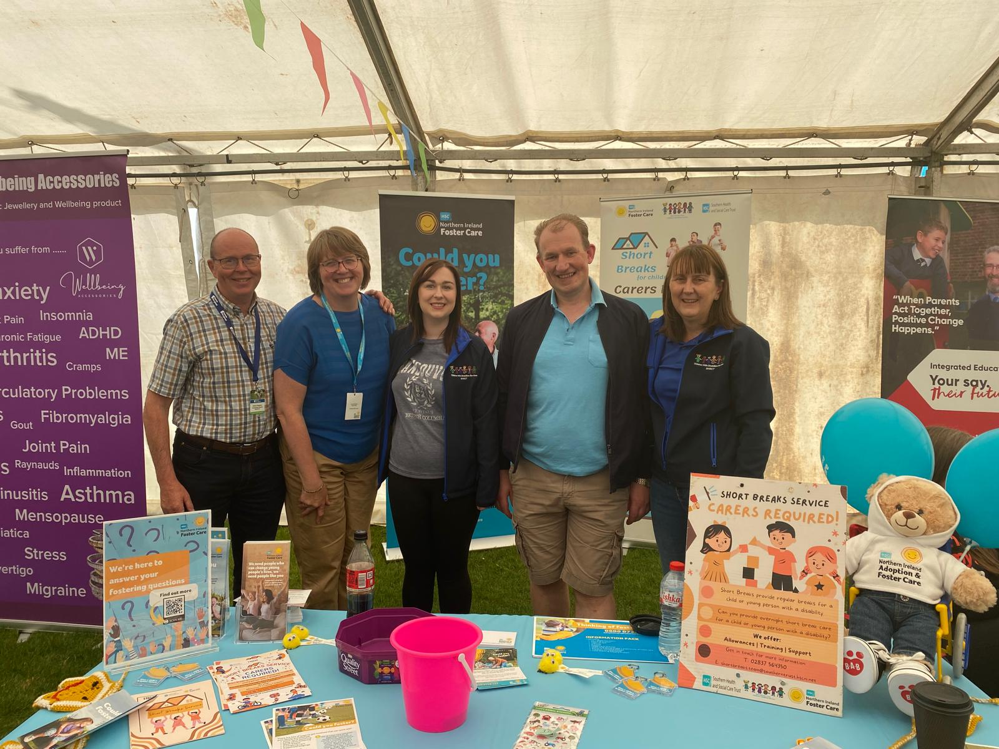
Words of Inspiration… Carers words….
“It’s joyful to become part of the foster care community. I soon realised what a lifeline short breaks offers to families of children with disabilities. I’ve received massive satisfaction.”
“I have walked in the shoes of a parent needing respite and carers. I understand how vital the service is to enable parents to look after a child with complex healthcare needs. I am delighted to be able to give back to parents/foster carers using the service in their time of need”.
Notes:
Angela to say -’ and some quotes from some of our Carers…on the screen’…
Angela to read her bit – (keep this slide on screen)

Slide 8
Words from a Parent...
“We appreciate the supports in place. This allows us to have time with our other son who also has needs.”
Notes:
Angela – to read out – ‘words from a parent’ – read quote

Slide 9
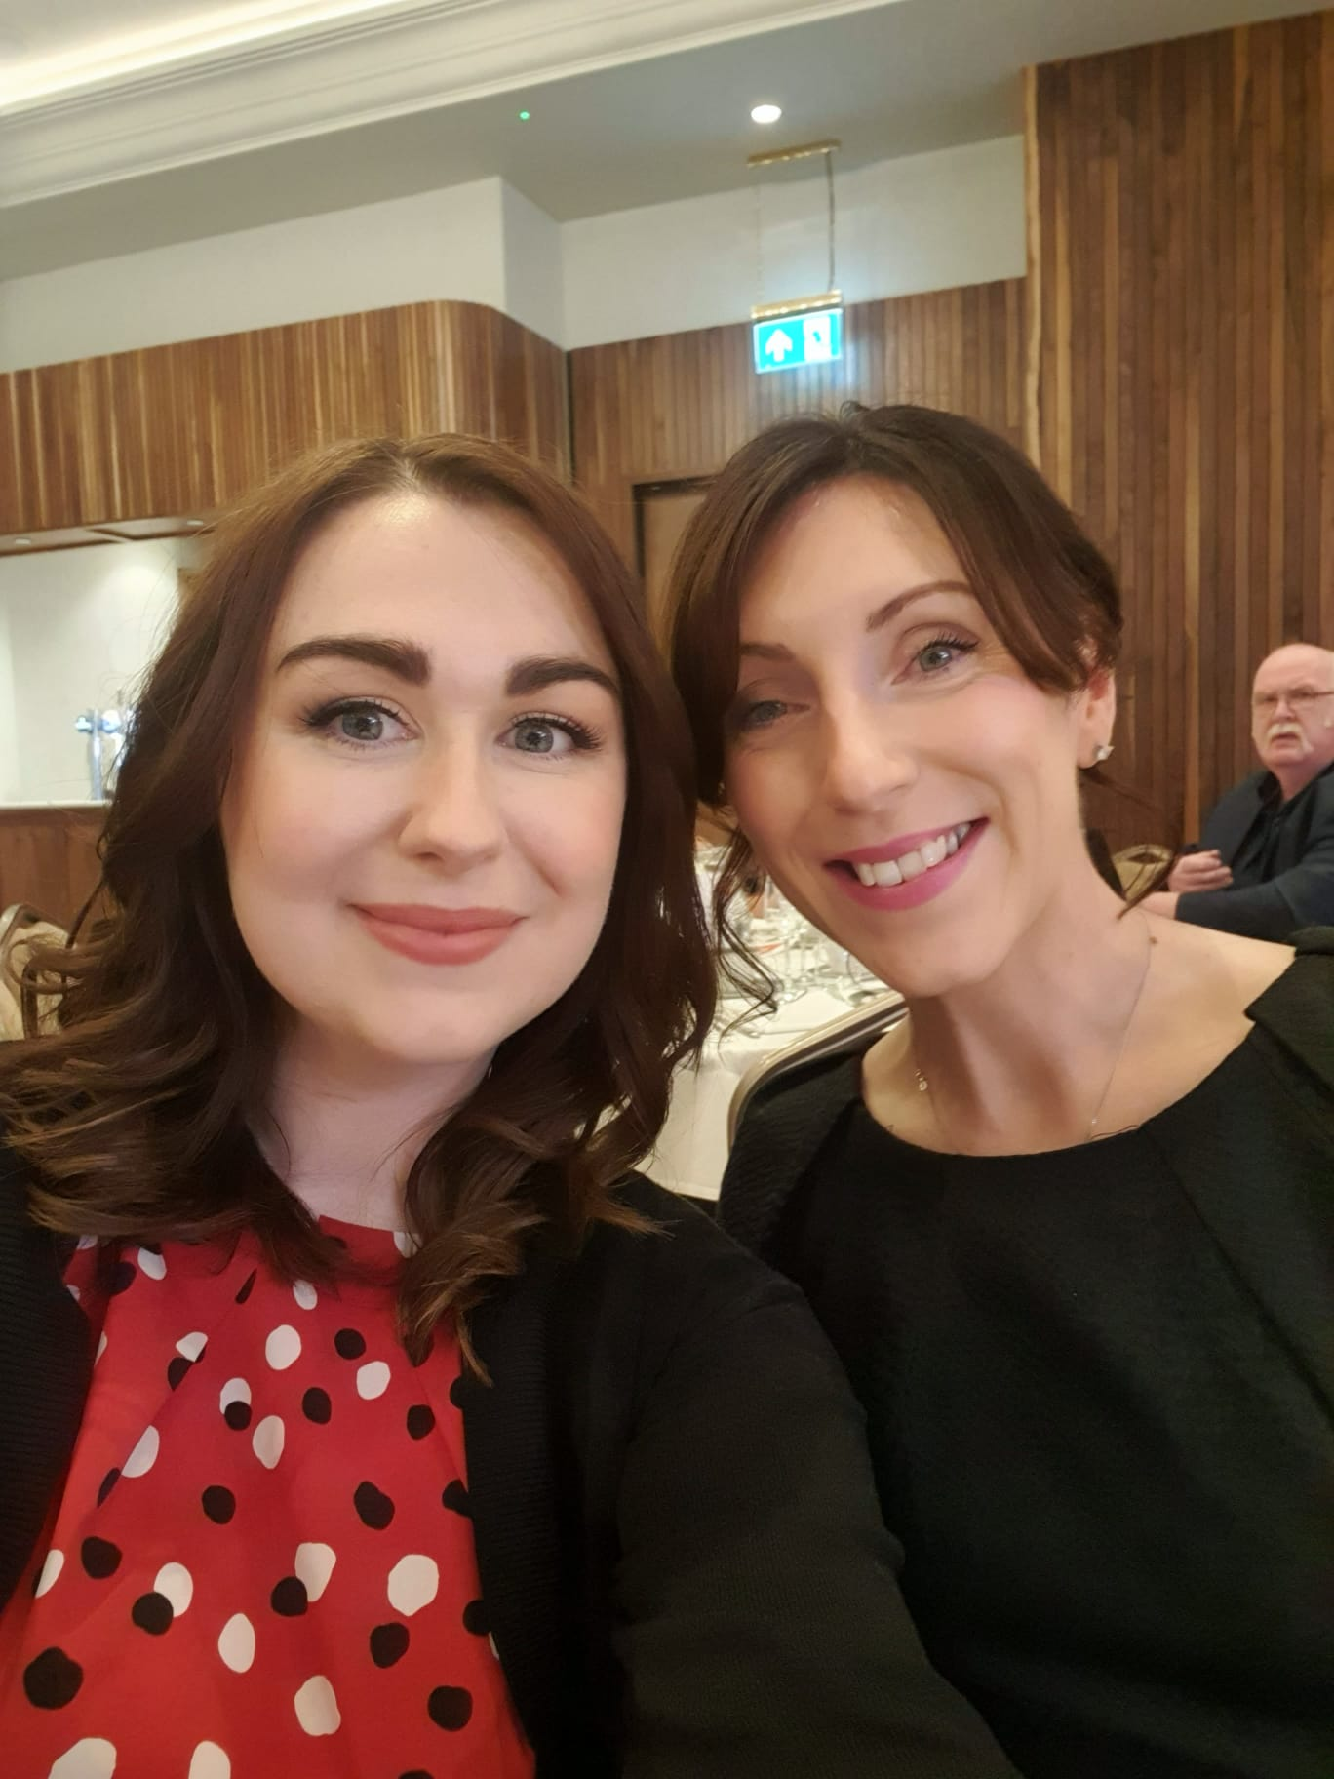
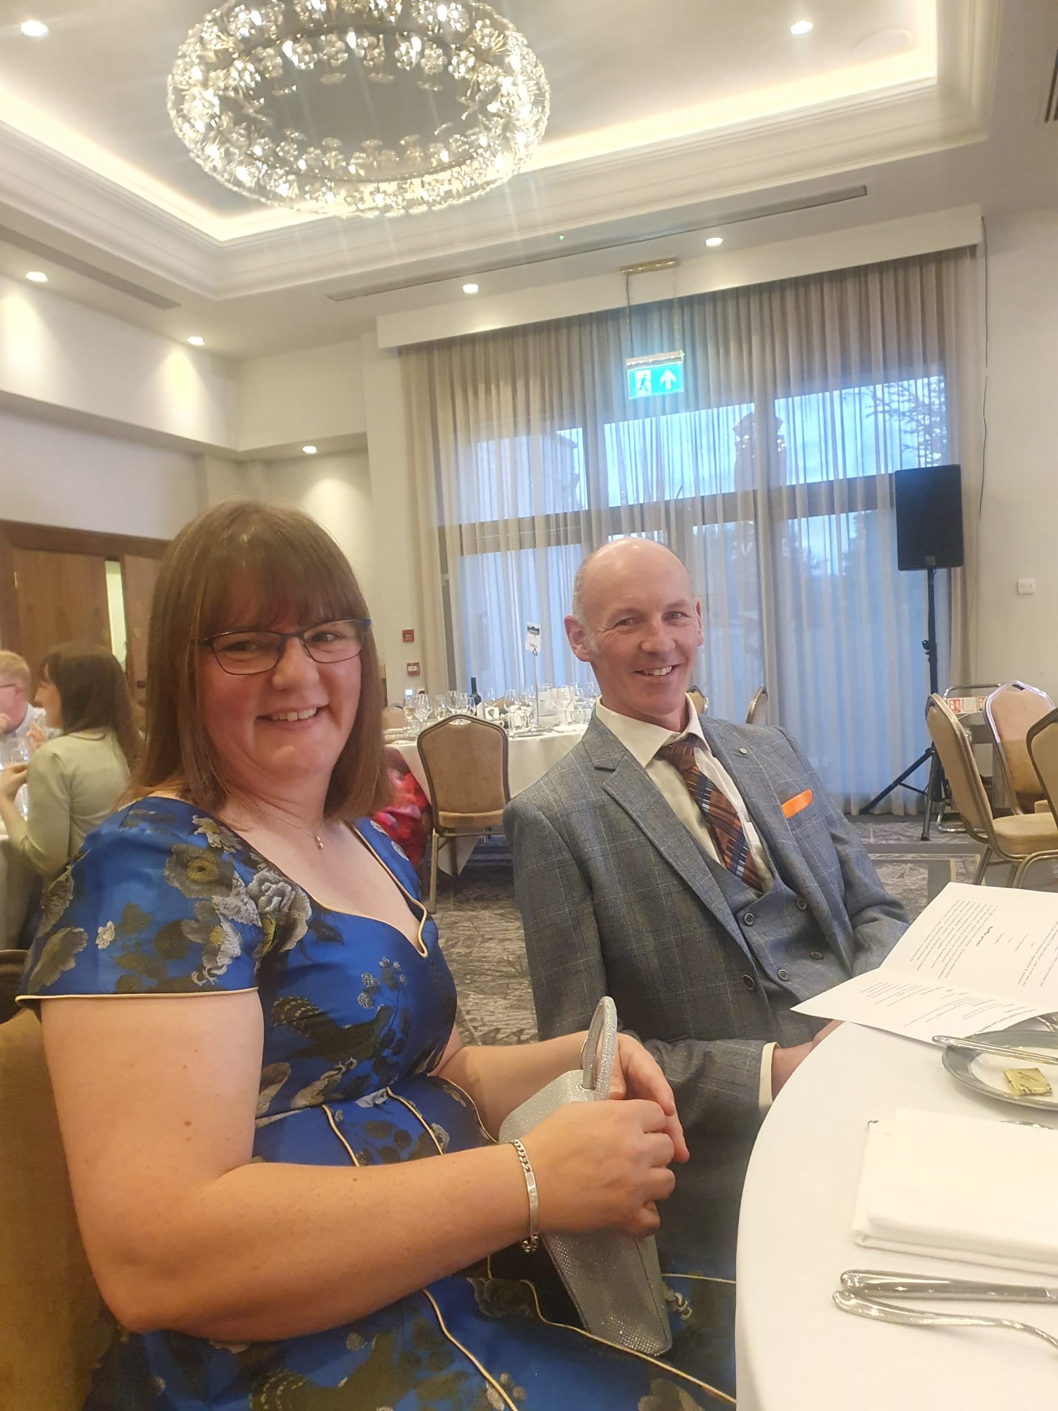
Northern Ireland Foster Care Awards
Notes:
Rachel to read her bit (keep this on screen)

Slide 10
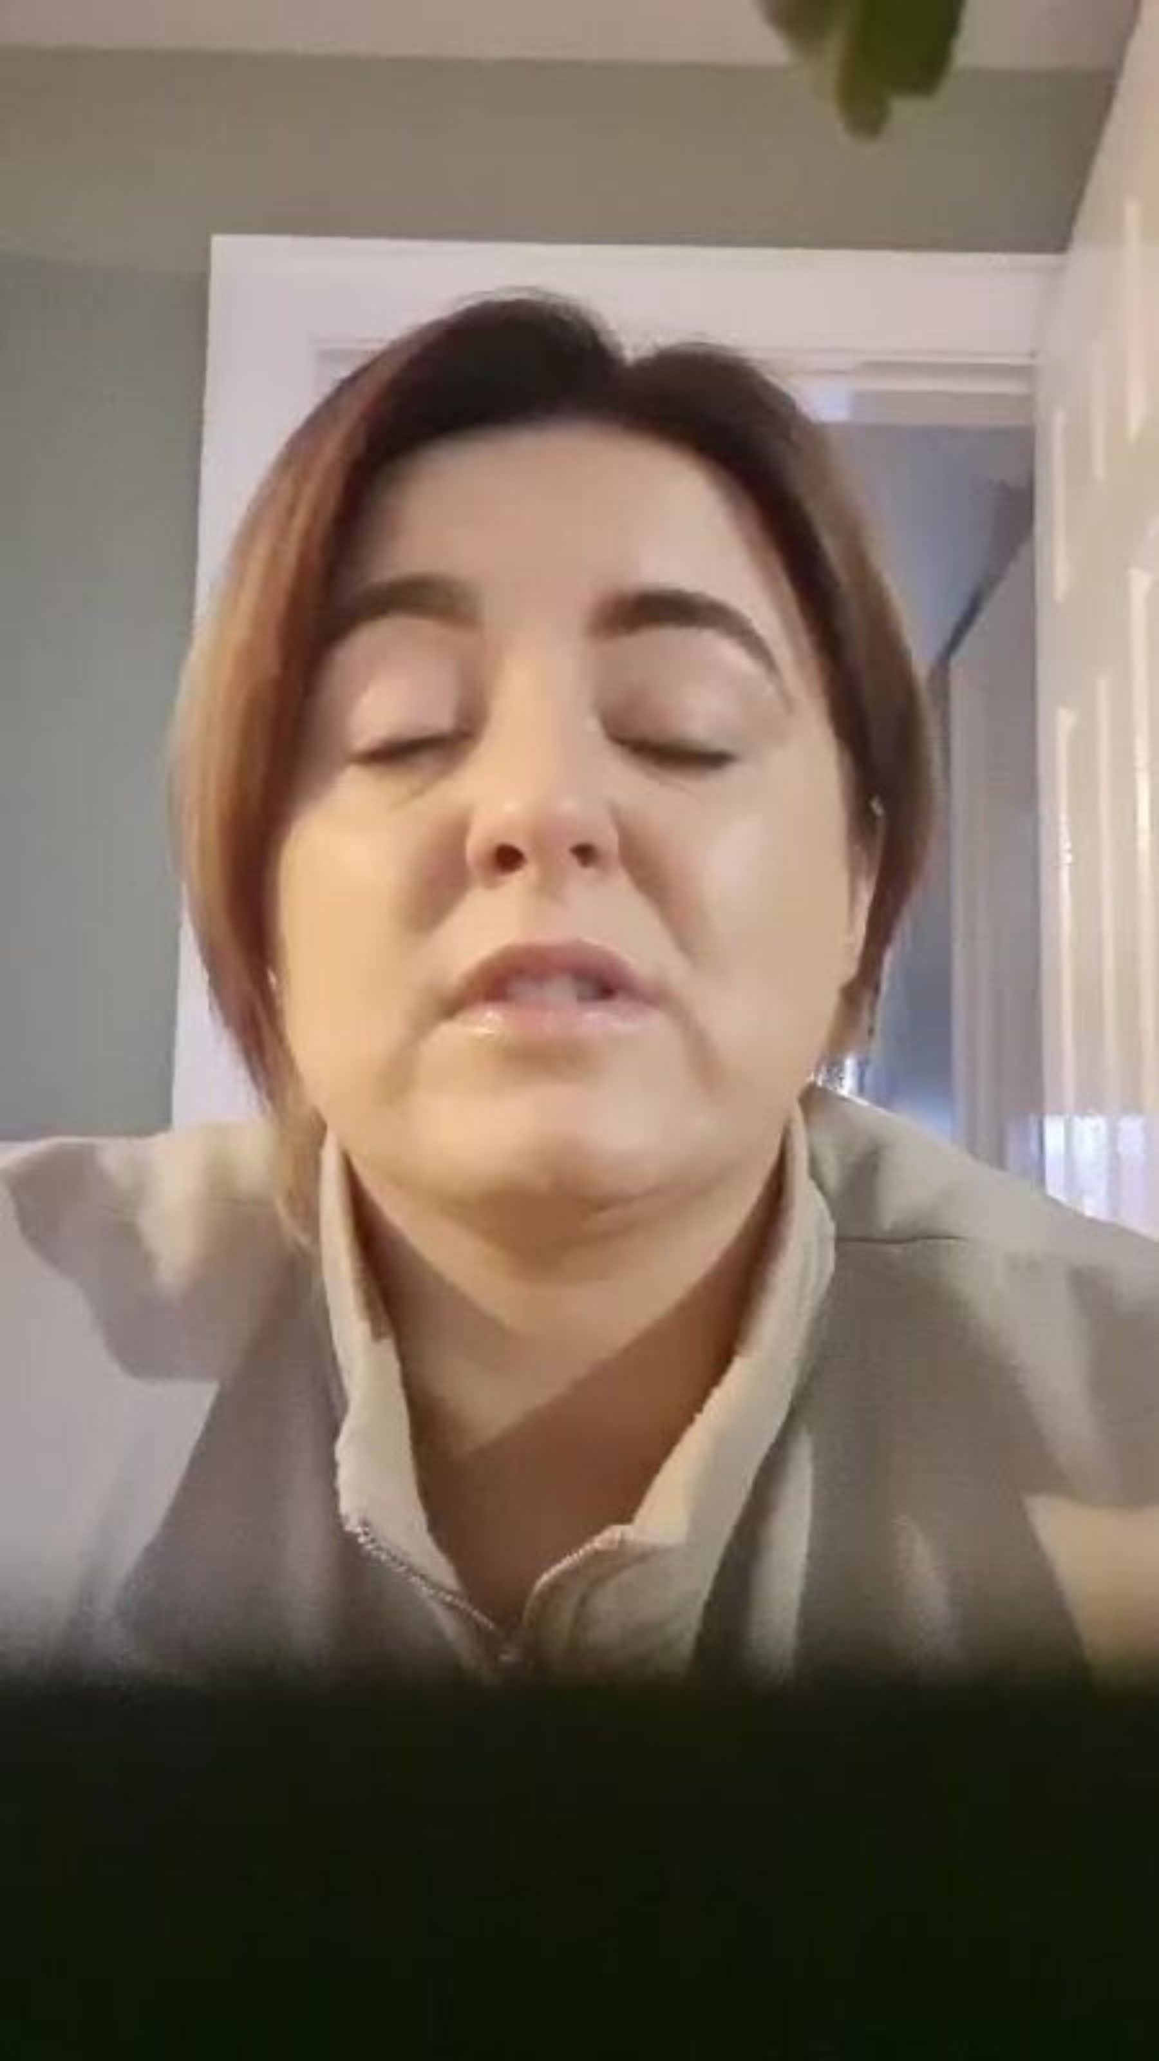
Video -Words from a Parent...
Notes:
Rachel – to read out – ‘we are now going to share a video from one of the Parents who is part of this service…’
Vicky to play video

Slide 11
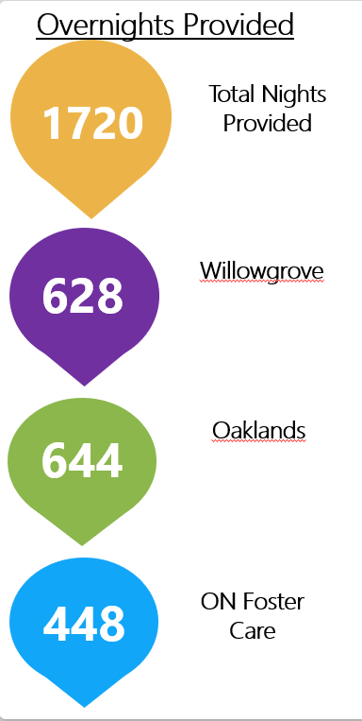
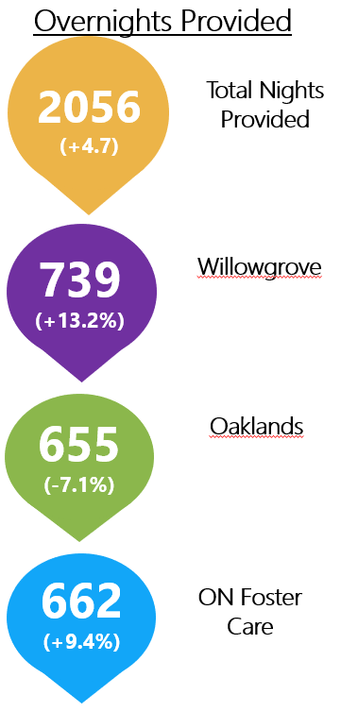

The Future … is bright
2021/2022
2023/2024
Notes:
Vicky to say – now Mark will now give a brief account of the future for the Short Breaks Service …
Mark to read his bit (one paragraph) (leave this slide on screen)

Slide 12



Words from a Young Person…
“I really like where I stay. I like it because it is close to the beach and the shops. I get on well with my foster carer because there is someone to play with”.
Notes:
Mark to read – I will end with words from one of our Young people …

Slide 13

THANK YOU
Any Questions?
Notes:
VICKY
Thank you to each of you for coming along today and sharing another inspiring story of some of the great work that Is going on within our Trust. Well done!
Thank you to the Trust Board for listening… if you have any questions the team will be happy to take them…
Thank you

