Slide 1

Finance Report
Month 7 October 2024
Finance Department

Slide 2
Contents
Financial Performance targets at October 2024 slide 3
Financial Plan 2024-25 slide 4
Financial position at October 2024 slide 5-7
Flexible Staff Costs as at October 2024 slide 8-9
Savings target 2024-25 slide 10-12
Forecasted Plan 2024-25 slide 13 - 14
Capital (CRL) at October 2024 slide 15
Risks to Delivery of Plan and Proposed Actions slide 16-17

Slide 3
1. Financial Performance Targets at October 2024
Financial Performance Targets | Year to Date | Year-end Forecast
1. Achieve financial plan in 2024-25 | Surplus £165k (Control v Actual) | Breakeven with control total spend £1.032m
The Trust is reporting a surplus of £165k at month 7 against control total. After completion of mid-year review a break-even position is forecasted due to the benefit of additional £1m Growth funding from SPPG, more positive progress on savings targets, in particular the overachievement in Nursing saving target and the positive benefit of Trust Unallocated adjustments.
2. Achieve 2024-25 savings target | Underachieved by £153k or 3% | £22m
The Trust Savings target is £22m including £5m additional target which has been retracted from month 7 onwards. Of the savings target of £7.6m at month 7, £7.5m or 34% has been achieved with an underachievement of £153k or 3% of the target to date. The main area of underachievement is within Medical Locum Conversion which is offset by overachievement to date in nursing, staff travel and GP OOHs to date. It is now anticipated that the full savings target of £22m can be achieved.
3. Achieve in year break even outturn within Capital Resource Limit (CRL) | £8.5m | £31.795m
As at month 7 £8.5m capital has been spent. The Trust is forecasted to spend a further £23.2m, £4.5m in General Capital and £18.7m in Specific schemes. This is normal for this time of year as schemes are planned for completion in latter months.
4. Prompt Payment Target - 95% of suppliers within 30 days | 97.3% | 96.3%
The Trust prompt payment performance in the month of October was 97.3% with cumulative position to date of 96.3%. Therefore, the Trust met its prompt payment target in October and on the cumulative year to date position is on target. A total of 34,052 invoices were paid in month.

Slide 4
2. Financial Plan 2024-25
After completion of the mid-year review the Trust is forecasting a break-even position with remaining pressures (being Encompass and Pension Flexibility) being covered by additional £1m growth funding from SPPG. It is also now anticipated that the MORE Pharmacy target of £1.3m will be achieved in full by year-end. Winter Plan funding of c£1.7m is in budget from November 2024. It is expected that underlying expenditure trends remain stable and within control totals and that the full £22m savings plans will be achieved due to more positive movement in savings targets reported at Month 07.
Key: brackets denotes an overspend

Slide 5
3. Financial position at October 2024
The table below shows Pay, Non-Pay and Income variances year to date for each Directorate. The second last column shows control totals variance at month 7 in thousandths (£165k surplus to date).
Deficit Funding continues to be reflected at Directorate level at month 7 with the Budget equal to the Control Total.
Following the mid-year review and based on the reforecast of spend for 2024/25 it is now anticipated that the Trust will achieve break-even by year-end.
A figure in brackets represents an overspend.

Slide 6
3. Financial position at October 2024
Explanations for main variances are as follows:
Payroll is over budget by c£1m the main area of pressure is Medicine & Unscheduled Care (MUSC). MUSC is overspent by £3.6m largely due to non-achievement of medical locum savings target and an overspend in medical pay predominately due to an increase in spend in DHH Stabilisation and ED Pressures.
Trustwide total Medical spend (substantive and all flexible costs) has increased by c£1.9m when compared to prior year adjusted for pay inflation.
The Trust Unallocated variance reflects the impact of profiling the deficit funding and pay adjustments. The re-allocation to Directorates of the £24m Trust Unallocated control total (inclusive of Growth funding and unallocated adjustments) will be agreed by Senior Leadership Team and reflected in Month 08 report.
Non-Pay is now reporting an overspend at month 7 budget of c£1m in the main due to additional x-ray maintenance contract spend.
Income is over-recovered by £2m, in the main due to over-recovery of Client Contribution income.

Slide 7
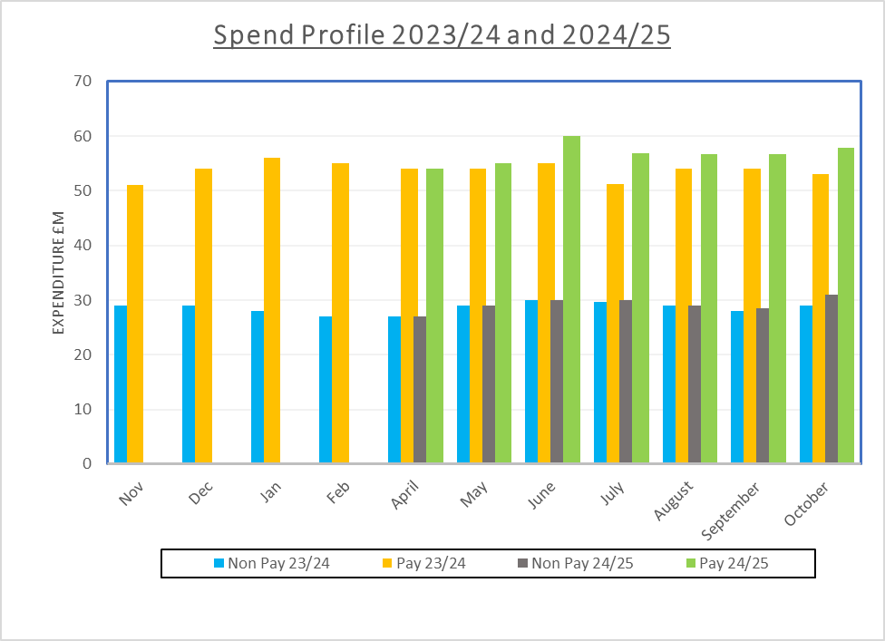
3. Financial position at October 2024
The profile of the expenditure in the Trust on Pay and Non-Pay rolling 12 months 2023/24 and 2024/25 is set out below. Pay in October 2024 has increased when compared to September 2024 by c£1.2m from £56.6m to £57.8m and has increased by c£4m compared to same period last year due to impact of DHH Stabilisation in later months. Non-Pay in October has increased by £2m compared to September and £2m compared to the same period last year, in the main due to spend on x-ray maintenance contracts.
Notes: The pay segment is impacted by the number of weeks which fall within the reporting month.
June 2024/25 includes the 2023/24 pay award

Slide 8
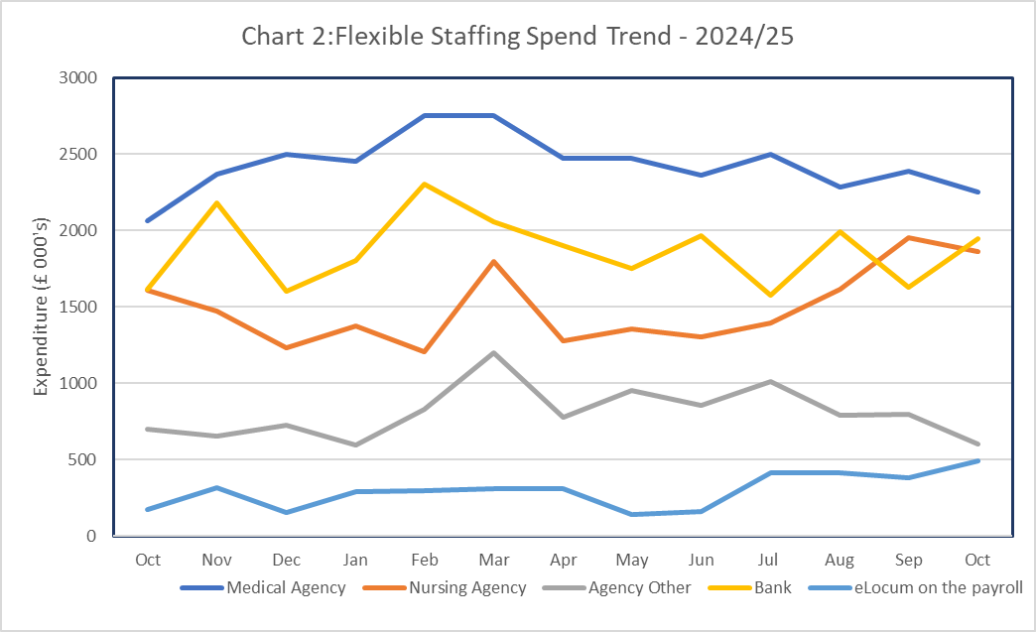
4. Flexible Staff Costs as at October 2024
Flexible staffing
The chart below shows Flexible Staffing Spend Trend rolling 12 months 2023/24 and 2024/25.
Medical Agency has decreased in October by £138k when compared to September, in the main due to savings from International Medical Recruitment, with the average monthly spend in first 7 mths of 24-25 (£2,392k) lower than that compared to last 7 months of 23-24 (£2,405k), However, eLocum spend has increased by £112k and cumulatively medical locum reduction savings are not being met as in total terms Medical spend (substantive and flexible) has increased.
Nursing Agency has decreased in month 7 by £86k however, is more than offset by increase in bank of £316k but cumulatively in total terms nursing spend (substantive and flexible) has decreased.
*Excludes Additional Duty Hours and Overtime

Slide 9
4. Flexible Staff Costs as at October 2024
The table above shows the flexible staffing by Directorate YTD October 2024. The total cumulative spend for flexible staffing in Mth 07 is £52.02m (13% of total payroll spend) with 1,516 WTE’s employed on these flexible arrangements.
The most significant area of flexible spend is Medical Agency £16.7m YTD. Overall flexible spend has increased by £42k in month when compared to prior month. Significant movements below:
Medical Agency decreased spend of £138k
Nursing Agency decreased spend of £86k
Other Agency decreased spend of £195k
Bank increased spend of £316k
eLocum on the payroll increased spend of £112k
Flexible staffing has decreased by £656k when compared to the equivalent period in 2023/24, however Medical Agency has increased by £2.55m when compared to the same period last year. MUSC overall flexible spend has increased by £2.091m mainly in Medical agency with an increase of c£2m and, ACS overall flexible spend has increased in the main to eLocum on the payroll with increase of £516k when compared to 23/24

Slide 10
5. Savings target 2024-25
Of the £22m Savings Targets, £7.6m has been retracted from budgets as at Month 07 (representing 35% of the overall target), £7.5m savings has been achieved to date with an underachievement of £153k against the target at Month 07. Details of the achievement against each of the 41 savings proposals is included in Table 6. After review it is anticipated that the following proposals will have limited or no achievement by year-end:
Proposal 26- Flex Spend- Other Agency & Bank £553k
Proposal 29- Internal Locum Conversion £2.799m
Proposal 37- Review Continuation of Long Covid Rehab Team £350k
Whilst the above schemes are expected not to achieved savings by year-end it is anticipated that any under-achievement can be addressed via over-achievement on other savings proposals and as reflected below:
Proposal 01 - Travel £397k
Proposal 26 – Nursing £1,170k
Proposal 41 – GPOOHS £680k
The additional £5m savings targets effective from October 2024 has been applied as follows:
£2m Nursing (added to Proposal 26) , £250k travel (added to Proposal 1) and £2.750m other staff efficiencies due to positive benefit of unallocated adjustments (added to Proposal 5).
It is anticipated that £22m forecast savings will be achieved if savings continue to be fully implemented.
Savings plans will be monitored and reported on at November RISE programme board.

Slide 11
5. Savings target 2024-25
Savings
Table 6: Low & Medium Impact Savings Plan 2024/25

Slide 12
5. Savings target 2024-25

Slide 13
6. Forecasted Plan 2024-25
The table below sets out the potential Best, Base (Plan) and Worst Case Scenarios based on current run rates, pressures and achievement of savings in month 7.

Slide 14
6. Forecasted Plan 2024-25 – Scenarios - basis of assumptions
Best Case Scenario: Assumes full achievement of £22m Low/Medium impact savings plans, additional pressures of c£900k will be addressed due to availability of additional growth funding of £1m from SPPG and that the Trust will underspend on control total by £2m.
Base Case Scenario: Assumes full achievement of £22m Low/Medium impact savings plans, additional pressures of c£900k will be addressed due to availability of additional growth funding of £1m from SPPG and Trust will breakeven.
Worst Case Scenario: Assumes full achievement of £22m Low/Medium impact savings plans, additional pressures of c£900k will be addressed due to availability of additional growth funding of £1m from SPPG but that the Trust will spend £2m over control total as Medicine & Unscheduled Care will not recoup overspend and spend will increase over winter period across all Directorates (over the funding envelope for Winter Pressures).

Slide 15
7. Capital (CRL) at October 2024
Risks
The table below show Capital (CRL) spend against budget at Month 7
As at month 7 £8.5m has been spent. The Trust is forecasted to spend a further £23.2m, £4.4m in General Capital and £18.7m in Specific. This is normal for this time of year as schemes are anticipated to complete in latter months.

Slide 16
8. Risks to Delivery of Plan and Proposed Actions
Risks
Risk 1 - To achieve the forecasted position costs must be contained within forecasted spend. The Trust is running at a surplus of £165k at Month 07 (control v actual) of which Medicine & Unscheduled Care is over by £3.6m mainly payroll due to non-achievement of medical agency target and increased medical pay costs and this will likely increase in winter period.
Proposed Action:
MUSC with support from the Medical Workforce Group, chaired by the Medical Director, continues to urgently review and ensure financial controls in place to address the increase in medical locum usage and non-achievement of medical agency target, in particular in DHH and in ED and over the winter months to contain spend within control totals.
Nursing Workforce groups to continue to review agency and bank spend and implement actions to further reduce/stop agency in agreed areas.
All Directorates avoid incurring spend that could give rise to a pressure or at risk spend.
Risk 2 - Savings target not being met by Directorates with underachievement of £153k at October 2024, largely due to medical locum conversion, delay in savings from closure of uncommissioned ward and delay in Bluestone staffing conversion.
Proposed Action:
Directorates to ensure robust plans are implemented to fully achieve all £22m savings targets. RISE to challenge and monitor non-achievement of targets. Medical workforce group to report on medical locum target.

Slide 17
8. Risks to Delivery of Plan and Proposed Actions
Risks
Risk 3 – Further pressures arise during the year which are unfunded.
Proposed Action:
No spend to be incurred without funding in place. Any unforeseen pressures to be reported to Finance and SPPG immediately.

